Slide 1



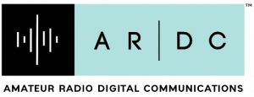


VLF Audio Module for the Tangerine SDR
Jonathan Rizzo
KC3EEY
Notes:
Hi, my name is Jonathan Rizzo, KC3EEY. I’m a VLF Natural Radio enthusiast and senior electrical engineering student at the University of Scranton. I’m currently designing a VLF module for the Tangerine SDR for automated reception of Natural radio emissions and amateur transmissions in the ULF and VLF bands. For a more detailed background on VLF natural radio and the motivation for this module, I invite you to view my TAPR DCC 2019 presentation “Ground Based Observation of Whistler Waves” on the Ham Radio 2.0 Youtube channel. For an example of a Raspberry Pi-based VLF automated reception system, I also invite you to view my HamSCI 2020 presentation “Using a PVC Pipe antenna and a Raspberry Pi to Detect VLF Natural Radio” on the Ham Radio 2.0 Youtube channel.

Slide 2
VLF Reception of Natural Radio Phenomena
For many years, researchers and enthusiasts have observed Natural Radio phenomena in the ULF/VLF band
Natural Radio Enthusiasts use homebrew VLF receivers
Researchers used sophisticated receivers and reception systems for Natural Radio study
Radio amateurs use the “Dreamer’s Band” at 8.720 kHz for amateur communications via carrier wave, slow speed CW, and coherent BPSK modes and have achieved worldwide QSOs.
Government, military, and navigational VLF transmitters are still utilized for reliable communication and navigation.
Notes:
VLF Natural radio has been observed for many years. Strange whistling sounds have been heard on telephone lines and by WW1 soldiers attempting to listen to enemy telephone lines with amplifiers. These accidental discoveries of Whistlers and other natural radio emissions have been a source of intrigue and curiosity, both by amateurs and professional researchers alike. Because these emissions are in the upper ULF and lower VLF band, constructing an effective receiver is possible with little effort. Enthusiasts have been constructing VLF receivers for personal listening and recording in radio quiet locations. Professional researchers have constructed sophisticated VLF reception systems with sensitive receivers for both the electric and magnetic component of these emissions as well as sophisticated DAQ systems and DSP techniques for study of lightning, natural radio, the ionosphere, and the magnetosphere. Radio amateurs have been doing VLF band communications for the past 10 years utilizing modes like QSO of a VLF carrier, slow speed CW, and a digital mode called coherent BPSK that utilizes a carrier locked to a GPS time reference for transmission of short text messages consisting of up to 100 characters. Worldwide QSOs and propagation distance records have been achieved. Governments around the world still use VLF transmitters for reliable communications for military and civilian use for communication and navigation. Even though the US OMEGA navigation system has been dismantled, the Russian counterpart, the RSDN Alpha Navigation System, is still in use today can can be still be heard around the world if band conditions are right.

Slide 3
Automated VLF Reception Systems
VLF Natural Radio emissions often occur randomly and can’t be predicted reliably.
Impractical to constantly listen for and record VLF emissions, as they can occur at inconvenient times and may never happen again for months!
Often times, a listener can listen with their portable receiver for months and not hear anything except sferics and tweeks.
Power line interference is a still a huge problem, and it’s getting worse!
Notes:
Due to the random nature of VLF natural radio occurrences and how sporadic they can be, especially chorus emissions, it really isn’t practical for the listener with a portable VLF receiver to listen for them unless substantial time and effort is put forth to catch them. Natural radio emissions often occur at inconvenient times, like the early morning or during bad local weather conditions. I used my portable VLF receiver quite often and didn’t hear a single whistler. This doesn’t mean these events don’t occur, you just have to be at the right time and the right place on Earth. Another issue is power line interference. 60Hz hum and its harmonics are radiated from power line conductors all the time, often changing in harmonic content as electrical loads like motors and switch-mode power supplies dump their harmonic byproducts back onto the power lines. Power line emissions can radiate for miles and still washout even the strongest natural radio emissions.

Slide 4
Automated VLF Reception Systems
Automation of VLF reception is a solution to the limitations of live listening and recording.
VLF receivers (E-Field and B-Field) (and their antennas) are permanently installed outside, either in a radio quiet location or where power line interference is not strong enough to overload the receiver.
VLF receivers are powered using either batteries or isolated DC.
The antenna (E-Field probe or B-Field loop) is connected directly to the receiver. Antenna feedlines are not used.
Feedlines from the receiver audio output transport the audio to the DAQ system inside.
Notes:
A great solution to the limitations and pitfalls of live listening is an automated VLF reception system. E-Field receivers are sensitive to the electric component of the wave and B-Field receivers are sensitive to the magnetic component. Both offer different advantages to the VLF enthusiast and researcher and automated systems often contain both, but either one can be used in a single receiver system. These receivers are installed outside, most of the time in a sealed enclosure and mounted on a mast along with their antenna and are powered by a battery (SLA is best) or isolated DC from the feedline. Current draw is usually very little so a SLA battery of a few amp hours can last for months. Isolated DC – DC converters can be used as well, but care must be taken so that their switching frequency is high enough not to cause interference in the VLF band. VLF audio and sometimes DC power is transported on the feedline running from the VLF receivers to the DAQ system. Unavoidable ground loops (due to the voltage difference between Earth ground and DAQ ground) cause mains hum injection into the receiver frontends via ground, so audio isolation transformers and isolated DC – DC converters are required.

Slide 5
Anatomy of an automated VLF Reception System
VLF receiver with preamp/filtering.
Can be either E-Field or B-Field receiver depending on the front end.
E-Field
  High impedance front end consisting of a JFET or op amp with some added gain, used as an impedance converter.
  JFET input stages use a gate resistor to set input impedance of the front end; antenna is connected directly to the gate, often with an inline choke.
  E-Field antenna is just an E-Field probe, connected directly to the input stage.
  Antenna length can be as small as one meter, often 2-3 meters in length.
  Since the antenna is a tiny fraction of the wavelength, the high impedance of the input stage.
Notes:
Automated VLF reception systems include the receivers and associated antennas, as well as the data acquisition system that provides the automation. The receivers can either be E-Field or B-Field receivers, and these systems utilize one E-Field receiver and two B-Field receivers for triple axis reception that allows for bearing and distance calculations of incoming VLF signals. E-Field receivers consist of a high impedance front end, either a JFET or op amp circuit with some added gain, used as an impedance converter. The gate resistor of the JFET sets the input impedance, usually 10M ohm or higher. The antenna is connected directly to the gate of the JFET or input to the op amp, usually with an inline choke. The output of the front end is much lower impedance, and is often filtered, then applied to an audio gain stage for headphone monitoring, or a feedline driver to drive a long length of cable back to the DAQ system. The antenna is a simple electric field probe connected directly to the input stage and Coax cable cannot be used due to impedance mismatch. The reason why such an electrically small antenna can be used is because of the high impedance of the input stage. If one were to use 5kHz as the middle of the VLF Natural Radio band, the wavelength would be 60000m! The impedance conversion is much more practical than even a quarter wavelength antenna.

Slide 6
Anatomy of an automated VLF reception System: E-Field Receiver
JFET Input Stage
(Impedance Converter and Gain Stage)
Filtering stage (Band Pass)
Output Stage
(Headphone or Feedline Driver)
Can be Op Amp input as well
Notes:
Here is a block diagram of a basic E-Field receiver showing the probe antenna, input stage, filtering stage, and output stage either consisting of a headphone or feed line driver. An earth ground or counterpoise is also required on the input stage, but it doesn’t have to be a “good” ground. The counterpoise created by grounding an E-Field receiver to your body is often very effective, especially in portable receivers that you hold in your hand. Another thing to keep in mind is that, when connecting to a DAQ system plugged into mains power, isolation transformers on both ends of the audio feedline are required to eliminate a ground loop that injects 60Hz hum into the input stage via ground. Another alternative is an amplitude modulated audio optical link via fiber optic cable for complete galvanic isolation. Power can be provided either via battery at the receiver site or from a feedline via DC to DC converters, however, isolated DC to DC converters must be used on both ends and their operating frequency needs to be high enough that it doesn’t cause interference in the VLF band.

Slide 7
Anatomy of an automated VLF Reception System
B-Field
  Frontend usually consists of an op amp circuit with added gain.
  Loop is coupled to the input of the op amp via an audio transformer.
  The audio transformer serves to match impedance; the low impedance of the loop to the high impedance of the op amp stage.
  Filtering is done after the frontend like in the E-Field receiver, then is amplified for a headphone monitor or a feedline driver circuit.
  Two loops (and two receivers) are required for East-West and North-South reception.
  The receiver also requires a good ground or counterpoise and feedline isolation.
Notes:
B-Field, or H-field, receivers consist of a loop antenna coupled to the front end via an audio isolation transformer to match impedance between the low impedance of the loop and the high impedance of the input of the op amp circuit. After the frontend, filtering is implemented, then passed to an audio gain stage for headphone monitoring, or a feedline driver to drive a long length of cable back to the DAQ system. To determine the bearing and direction of incoming VLF signals, two orthogonal B-Field loops are required for North-South and East-West bearings. VLF enthusiasts often employ orthogonal loops for “stereo” listening of VLF signals. The magnetic component of observed natural radio emissions often has different signal and propagation characteristics and can provide additional information than the electric component can. Whistlers and tweeks are often stronger in the B-Field than the in E-Field and provide additional signal and propagation information. B-Field receivers require a good ground or counterpoise connection on the input stage and feedline isolation on both ends.

Slide 8
VLF Receivers: B-field Receivers
Loop Antenna (Can be two loops orthogonal to each other for N-S and E-W channels
Audio Transformer and Op Amp Input Stage
(Impedance Converter and Gain Stage)
Filtering stage (Band Pass)
Output Stage
(Headphone or Feedline Driver)
Notes:
Here is a block diagram of a basic B-Field receiver showing the loop antenna, input stage, filtering stage, and output stage either consisting of a headphone or feed line driver. An earth ground or counterpoise is required on the input stage for good receiver sensitivity. It is recommend to use shielded loops in automated reception systems because noise sources often come and go, especially with dynamic power line interference from harmonic generation originating from electric motors and switch-mode power supplies. These harmonics are injected back onto the power lines and can radiate for miles. Audio isolation transformers on both ends of the audio feedline are also required and is powered in the same way.

Slide 9
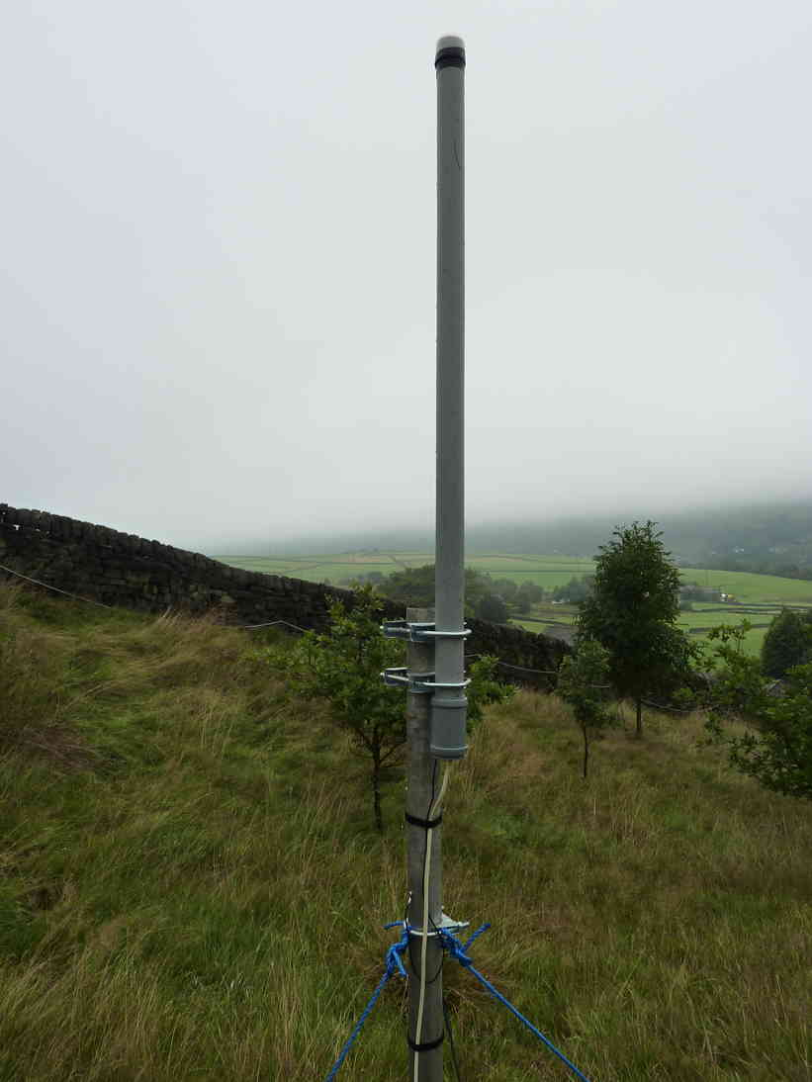
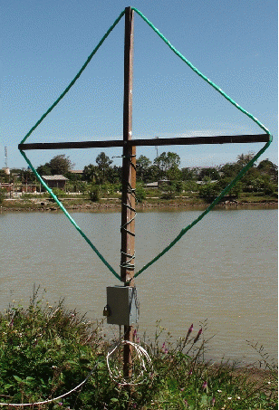
Permanent VLF Observation
Image taken from VLF Experimentation Facebook Group and vlf.it
Notes:
Here is an example of an installed E-field receiver on the left. The receiver electronics are enclosed in the PVC pipe and the feedline and ground wire come out the bottom, while the antenna element is inside and is in most of the length of the pipe. On the right, is a B-field receiver with loop antenna. The receiver electronics are housed inside the gray enclosure and the feedline and ground come out the bottom. The loop connects from the top.

Slide 10
DAQ System
The simplest DAQ system is an audio recorder. These days, digital audio recorders are used.
For the serious enthusiast, a computer with a soundcard and appropriate software is often used. Appropriate software includes Spectrum Lab or vlfrx-tools.
For the professional researcher, a professional DAQ from National Instruments or other DAQ manufacturer.
Sometimes, a complete custom DAQ solution can be utilized by the professional researcher to fit their needs.
Notes:
The DAQ system captures the VLF audio and records it digitally, sometimes adding a timestamp referenced to GPS time, for correlation purposes. After recording and timestamping, the data is processed using DSP techniques for filtering, event detection, event storage, and visualization. The simplest DAQ is a digital audio recorder. For the serious enthusiast, a computer with a good soundcard, a GPS PPS signal, and appropriate software like Spectrum Lab or vlfrx-tools, can be used to capture, record, filter, event detection, and audio streaming for live listening. Professional researchers often use commercial DAQs like one from National Instruments or other manufacturers. They can also create custom DAQ solutions, like the AWESOME receiver designed by researchers at Stanford University.

Slide 11
vlfrx-tools
Open source VLF radio toolkit for capture, analysis, and storage.
VLF audio and GPS PPS fed into soundcard. (Cannot feed GPS PPS into parallel or serial port)
Automatically filters power line hum with tracking filter.
Detects whistler and chorus events automatically and lightning location through TOGA method.
Can support triple axis reception. (E-field, N-S B-field, E-W B-field)
Can detect Sudden Ionospheric Disturbances.
Can determine bearing and distance of VLF signals. (triple axis required)
Can be compiled on Linux, FreeBSD, and OpenBSD. (BSD preferred)
Audio streaming via icecast server of VLF audio for live listening.
Notes:
Vlfrx-tools is an open source VLF receiver toolkit for signal capture, analysis and storage of VLF signals and events. It’s written by Paul Nicholson, a VLF enthusiast very active in the VLF community. VLF audio and a GPS PPS signal is fed into the soundcard of the computer. vlfrx-tools captures the VLF audio and timestamps each sample. Offset correction is applied to the timestamp so they align to GPS time. The signal is then is applied to tracking filter that tracks mains hum and removes it and its harmonics. The filtered signal is then fed into a whistler and chorus event detector that logs each event. Lightning location can be accomplished with sferic time of group arrival. Bearing and distance of incoming VLF signals can be determined with triple axis reception. Sudden Ionospheric Disturbances can be detected with phase measurements from VLF transmitters. The source code can be compiled on BSDs and Linux, and live listening can be done via streaming to an icecast server.

Slide 12
vlfrx-tools System Diagram
E-field VLF Receiver
vtcard
vttime
vtfilter
vtcat
vtevent
Whistlers/Chorus
Trimble Timing RX PPS
vttoga
Sferic TOGA
B-field N-S VLF Receiver
vtcard
vttime
vtfilter
vtvorbis
VLF Stream
B-field E-W VLF Receiver
vtcard
vttime
vtfilter
vttime outputs
vtwrite
HDD
Notes:
This is a block diagram of the signal flow between the utility programs of vlfrx-tools utilizing circular buffers and named pipes for transport. Audio and the PPS signal come in through vtcard where each sample is timestamped. Offset correction is applied through vttime. The 60Hz hum and harmonics is removed with the tracking filter of vtfilter. The signal is them combined into a three channel stream with vtcat, and sent off to the event detector, vtevent, and the TOGA utility, for TOGA calculations. It’s also sent to vtresample that downsamples the stream and vtvorbis that sends it to an icecast server for live listening. The VLF audio module for the Tangerine SDR will replace the soundcard and use the GPSDO for timestamping. It will produce a stream with combined channels like vtcat does and present them over a TCP socket via the dataengine’s Ethernet port. Any server on a local network or the internet running vlfrx-tools can accept this multichannel stream and perform the various tasks such as event detection, SID detection, TOGA measurements and data exchange, streaming, and signal archival, all without the need for a high quality soundcard and computer.

Slide 13
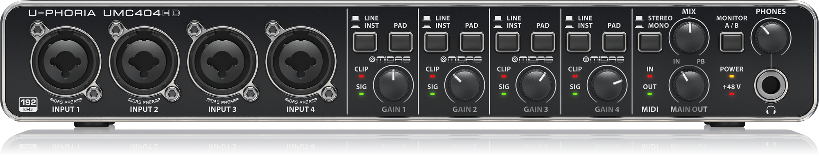
VLF Audio Module: Inspiration
A post on the VLF Natural Radio groups.io group talking about the performance of the Behringer UMC404HD professional USB audio interface as a DAQ instead of a high quality PC soundcard.
Paul Nicholson liked it so much that he employed it in his automated VLF reception system replacing the M-Audio 192 PCI he was currently using. It performed as well or better in his testing.
The UMC404HD utilizes Cirrus Logic CS4272 24-Bit, 192 kHz Stereo Audio CODEC for analog to digital conversion with 114dB dynamic range.
The UMC404HD also utilizes the AD8694, NJM2122, and RC4850 op amps for analog filtering and gain stages.
Notes:
Inspiration for the VLF Audio Module came from a post on the VLF Natural Radio Groups.io Group with the discussion of the Behringer UMC404HD Professional USB audio interface, for professional audio and music recording applications. It has 4 analog inputs and can sample at up to 192kHz and was discussed as a high quality capture interface for VLF and GPS PPS signals. Paul Nicholson decided to try it out on his automated VLF reception system that previously employed an M-Audio 192 PCI high quality sound card. He found it performed better or the same in much of the testing he did, and decided to use it in production instead. It utilizes a cirrus logic CS4272 24-bit 192kHz stereo Audio Codec for analog to digital conversion with 114dB of dynamic range. It also utilizes the AD8694, NJM2122, and RC4850 op amps for analog filtering, gain, and buffer stages. Here is the front panel. The USB port is on the back.

Slide 14
VLF Audio Module: Inspiration
For the VLF audio module, the Cirrus Logic CS4272 was not a good choice.
Only two analog input channels are available. At least three are required for the VLF Audio Module.
The Cirrus Logic CS4272 is a CODEC, which means both analog inputs and outputs. Only analog inputs are required.
An alternative with at least 3 analog input channels, and input channels only is required for the VLF Audio module.
A single IC simplified design and can offer the same performance.
Notes:
For the VLF audio module, the CS4272 was not a good choice. Only two analog input channels are available. At least three are required for the VLF audio module, and ideally 4 for a backup receiver. It’s also a CODEC, so that means there are analog outputs as well, which are not required and won’t be utilized. So, an alternative had to be found with at least 3 analog input channels and no analog outputs. Since it simplifies hardware design, a single IC solution can be used with the same performance.

Slide 15
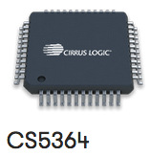
VLF Audio Module: Design
The VLF audio module will use the Cirrus Logic CS5364 114 dB, 192 kHz, 4-Channel A/D Converter.
Master clock will be obtained from one of the programmable clock channels from the GPSDO.
Audio samples transported via I2S or TDM port to the Data Engine FPGA.
FPGA will set active A/D channels, sampling rate, sample length, and master clock frequency based on user settings.
Interfaces to the Data Engine as a LEAF board; I2S/TDM port connects via M.2 connector and I2C control via the RPi I/O header.
Possibly EEPROM for board ID.
Notes:
I chose the Cirrus Logic CS5364. It offered 4 analog inputs and no analog outputs, with a dynamic range of 114dB. The master clock is obtained from one of the programmable clock channels from the GPSDO. Audio samples are transported via the I2S or TDM port to the data engine FPGA. I2S only supports 2 channels and TDM can support 4. The FPGA will set the number of active channels, sampling rate, sample length and master clock frequency based on user configuration settings. The VLF Audio module interfaces to the data engine as a LEAF board. The I2S or TDM port is connected to a high speed serial bus on the M.2 connector and I2C control via the Raspberry Pi I/O header. It may have an EEPROM for LEAF board ID.

Slide 16
VLF Audio Module: Operation
VLF audio feeds will connect to screw terminals via audio isolation transformers.
FPGA configures the active channels (1-4), sampling rate, sample length, and master clock via I2C.
The FPGA configures the GPSDO DDS channel to generate the master clock frequency required for the configuration.
Samples are transported via I2S or TDM (1-2/1-4 channels) to the FPGA.
FPGA timestamps the sample referenced to GPS time the same way vtcard timestamps the sample.
FPGA streams the samples to a TCP socket via the Ethernet port compatible with vlfrx-tools.
FPGA combines channels into a single multichannel stream in the same way as vtcat.
Notes:
For operation, the user connects the VLF audio feeds via audio isolation transformer to the appropriate screw terminals. The FPGA configures the active channels, from 1 to 4, the sampling rate, sample length, and master clock configuration via I2C based on user configuration settings. It also configures the GPSDO Programmable DDS channel to generate the master clock frequency required for the configuration. Samples are transported via I2S or TDM to the FPGA and are timestamped referenced to GPS time the same way vtcard timestamps a sample. Because the master clock derived from the GPSDO and the low latency of the FPGA, the timestamps do not need offset correction. The channels are combined into a stream in the same way vtcat combines channels and is presented to the Ethernet port via a TCP socket. Channels are combined in the same way as vtcat combines them, and timestamps are applied in the same way as vtcard applies them so the stream is compatible with vlfrx-tools, and the Tangerine SDR and VLF audio module can provide a high quality VLF capture and timestamp interface in a compact, networked SDR.

Slide 17
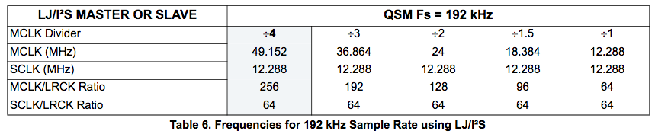
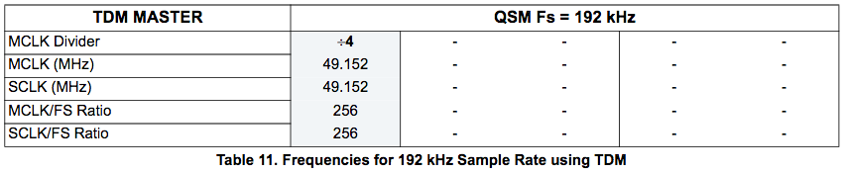
VLF Audio Module: Clocking
Notes:
These tables are taken from the datasheet. For 192kHz in either I2S or TDM modes, quad speed mode must be used. Depending on how the master clock divider is chosen, one must select the appropriate master clock frequency and the serial clock and word clock are generated by the CS5364. For the TDM mode, only the serial clock is generated.

Slide 18
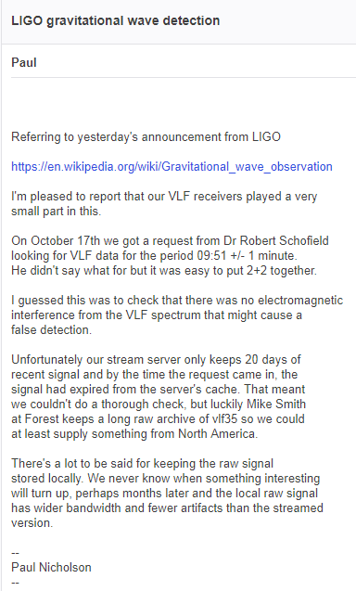
VLF Audio Module: Why VLF Automated Reception Systems are Important
Notes:
VLF automated reception systems are an invaluable resource for science. According to an anecdote from Paul Nicholson written on the VLF Natural Radio Yahoo Group, Dr. Robert Schofield, a physicist involved in the LIGO experiment that confirmed the existence of gravitational waves as predicted by Einstein, was tasked with verifying that terrestrial sources of noise, such as sferics, did not generate false detections in LIGO data. Dr. Schofield contacted Paul and requested timestamped VLF data, but he did not have recorded data in his server’s cache for that time period, so Paul contacted Mike Smith, a VLF enthusiast that supplies a VLF stream to Paul’s servers. Mike uses a high quality sound card sampling at 192kHz to capture a wider bandwidth than the downsampled streamed version of the data Paul had on his servers, and he had data for the time period that Dr. Schofield needed. Data was provided to Dr. Schofield. So, the VLF reception system and network from Paul and Mike played a small part in one of the biggest discoveries of physics in recent years. This is why these VLF reception systems are so important. A VLF receiver built with old answering machine parts and a Tangerine SDR has the potential to do amazing things!

Slide 19
VLF Audio Module: Thank you!
We gratefully acknowledge support to this project from NSF Grants AGS-2002278, AGS-1932997, and AGS-1932972.
I’d like to offer my gratitude to the following:
  National Science Foundation for financial support.
  Amateur Radio Digital Communications for financial support.
  University of Scranton for financial support.
  Tom McDermott N5EG and Scotty Cowling WA2DFI for technical support.
  Dr. Nathaniel Frissell W2NAF for endless support and motivation for this project.
  Paul Nicholson for his endless support, vlfrx-tools, contributions to this project and the VLF community at large.
Notes:
I’d like to thank the following: National Science Foundation for financial support via the listed grants, Amateur Radio Digital Communications, and University of Scranton for financial support; Tom McDermott N5EG and Scotty Cowling WA2DFI for their technical support; Dr. Nathaniel Frissell W2NAF for his endless support, motivation, and inspiration; and Paul Nicholson for his amazing support and assistance he has given to me, his amazing software vlfrx-tools, and his contributions to myself, my projects, and the VLF community at large.

