Slide 1
Magnetometer Characterization for Space Weather Observation
    David Witten KD0EAG, TAPR
    Hyomin Kim KD2MCR, New Jersey Institute of Technology
with assistance from Gil Jeffer and Sungjun Noh and others
Julius Madey, K2KGJ
We gratefully acknowledge support to this project from NSF Grants AGS-2002278, AGS-1932997, and AGS-1932972.
TAPR would also like to acknowledge the generous ARDC grant in support of the prototype build.

Slide 2
Magnetometer Characterization: Critical Parameters
Sensitivity: Does the sensor provide the sensitivity required for meaningful measurements?
Noise: Are the measurements susceptible to corruption in a realistic environment?
Accuracy: Do the measurements obtained correlate to ones made by reference instruments?
Packaging: Can these sensors provide repeatable measurements over time in hostile deployments?

Slide 3
Software for Testing
Very little initial discussion.
You cannot test much without it.
Software “just happens” when discussing hardware.
Requires LOTS of time and debugging to make something actually useful.
Never seems to be finished.

Slide 4
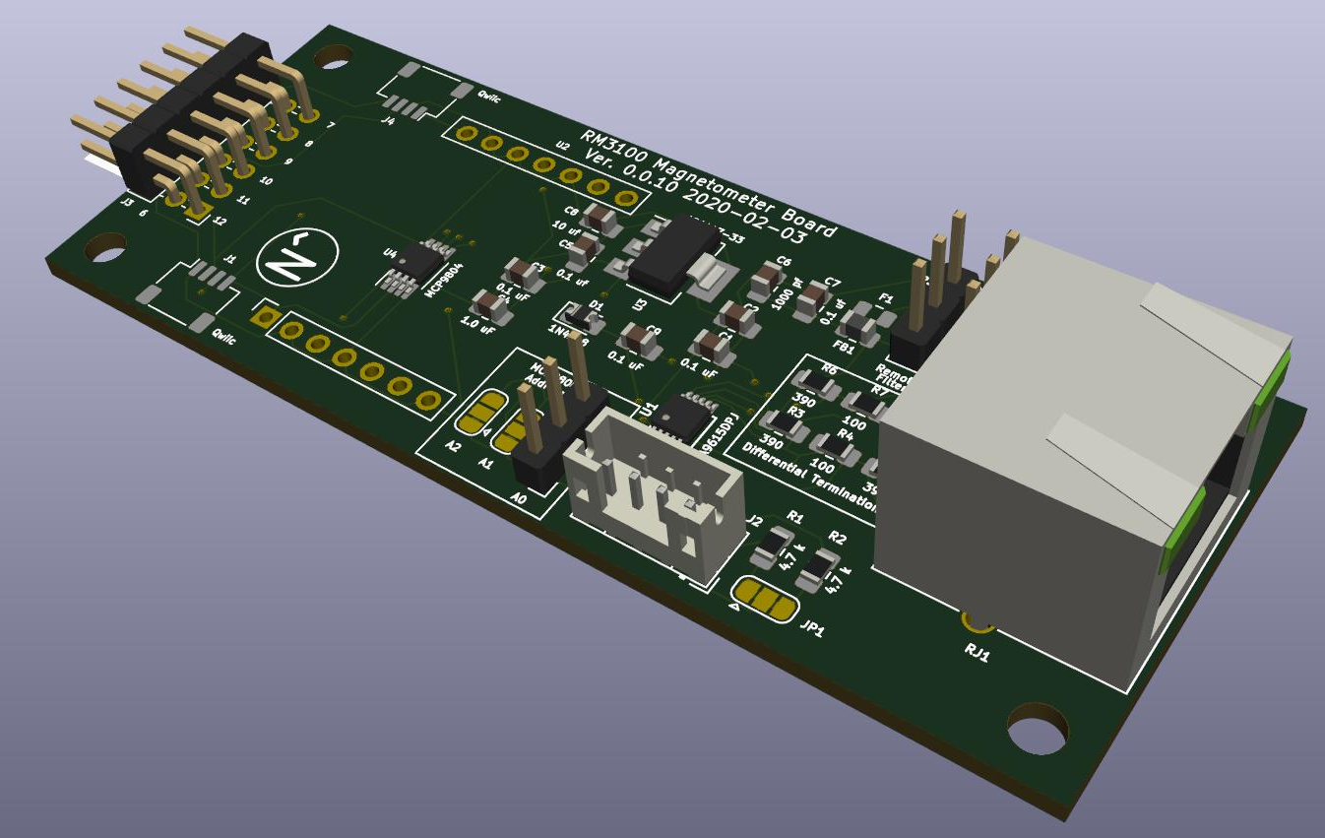
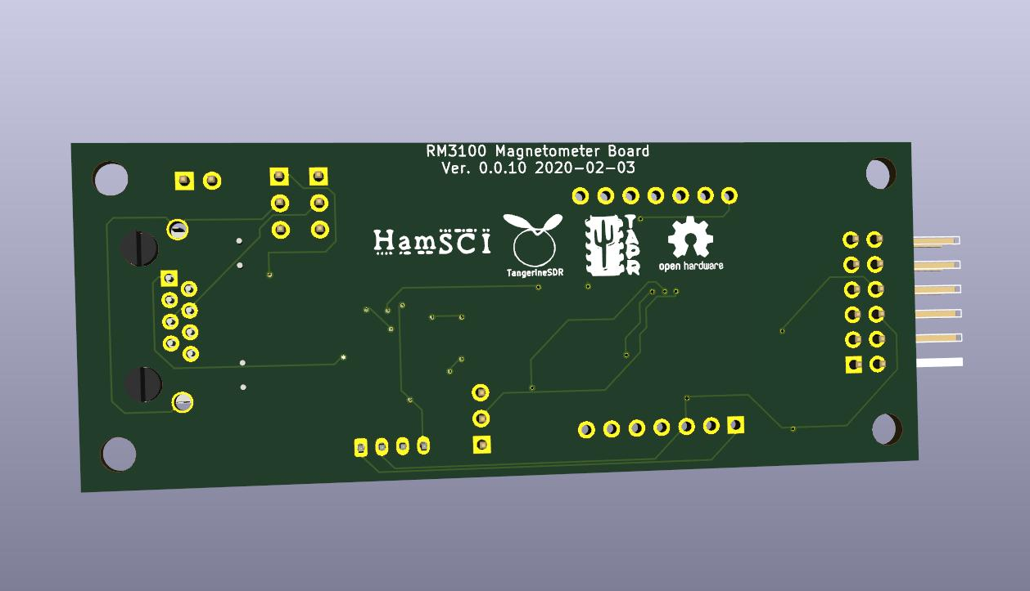
Prototype 3D Mock-Up

Slide 5
PNI RM3100 Magnetometer Module
3 axis magneto-inductive measurement module.
Low cost (≤ $20) allows widespread deployment.
Very small (25.4 mm x 25.4 mm x 8 mm) compared to other sensor types.
High sensitivity alternative to other magnetometer types.
Manufacturer claims 13 nT with default settings.

Slide 6
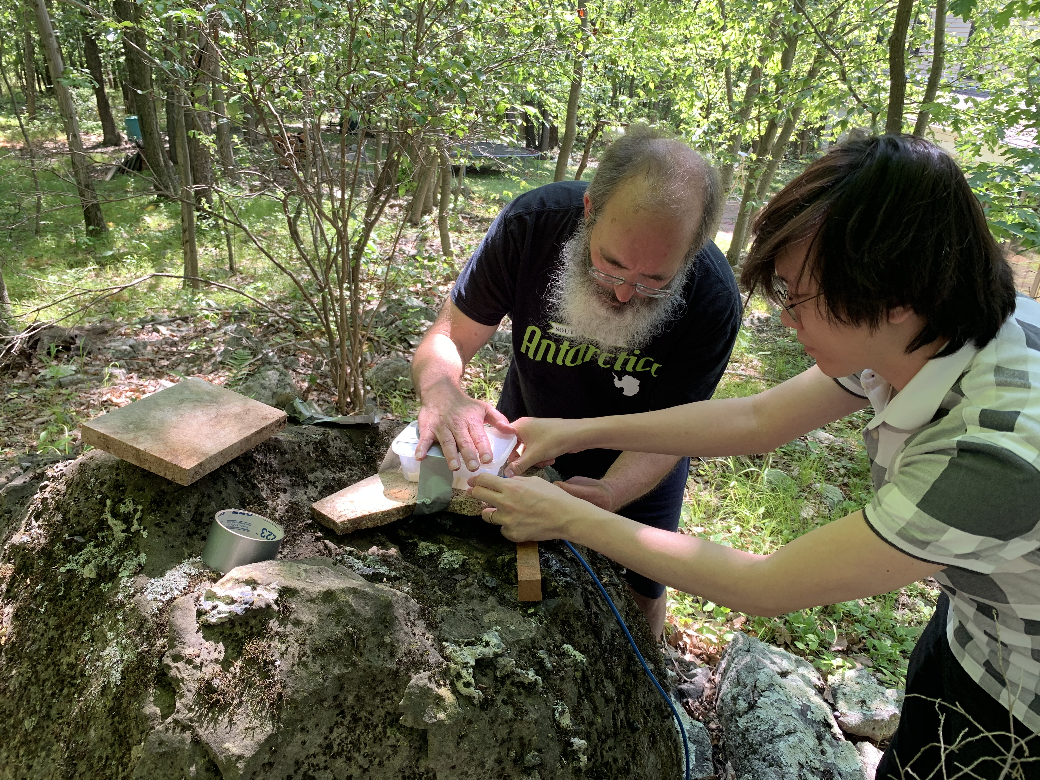
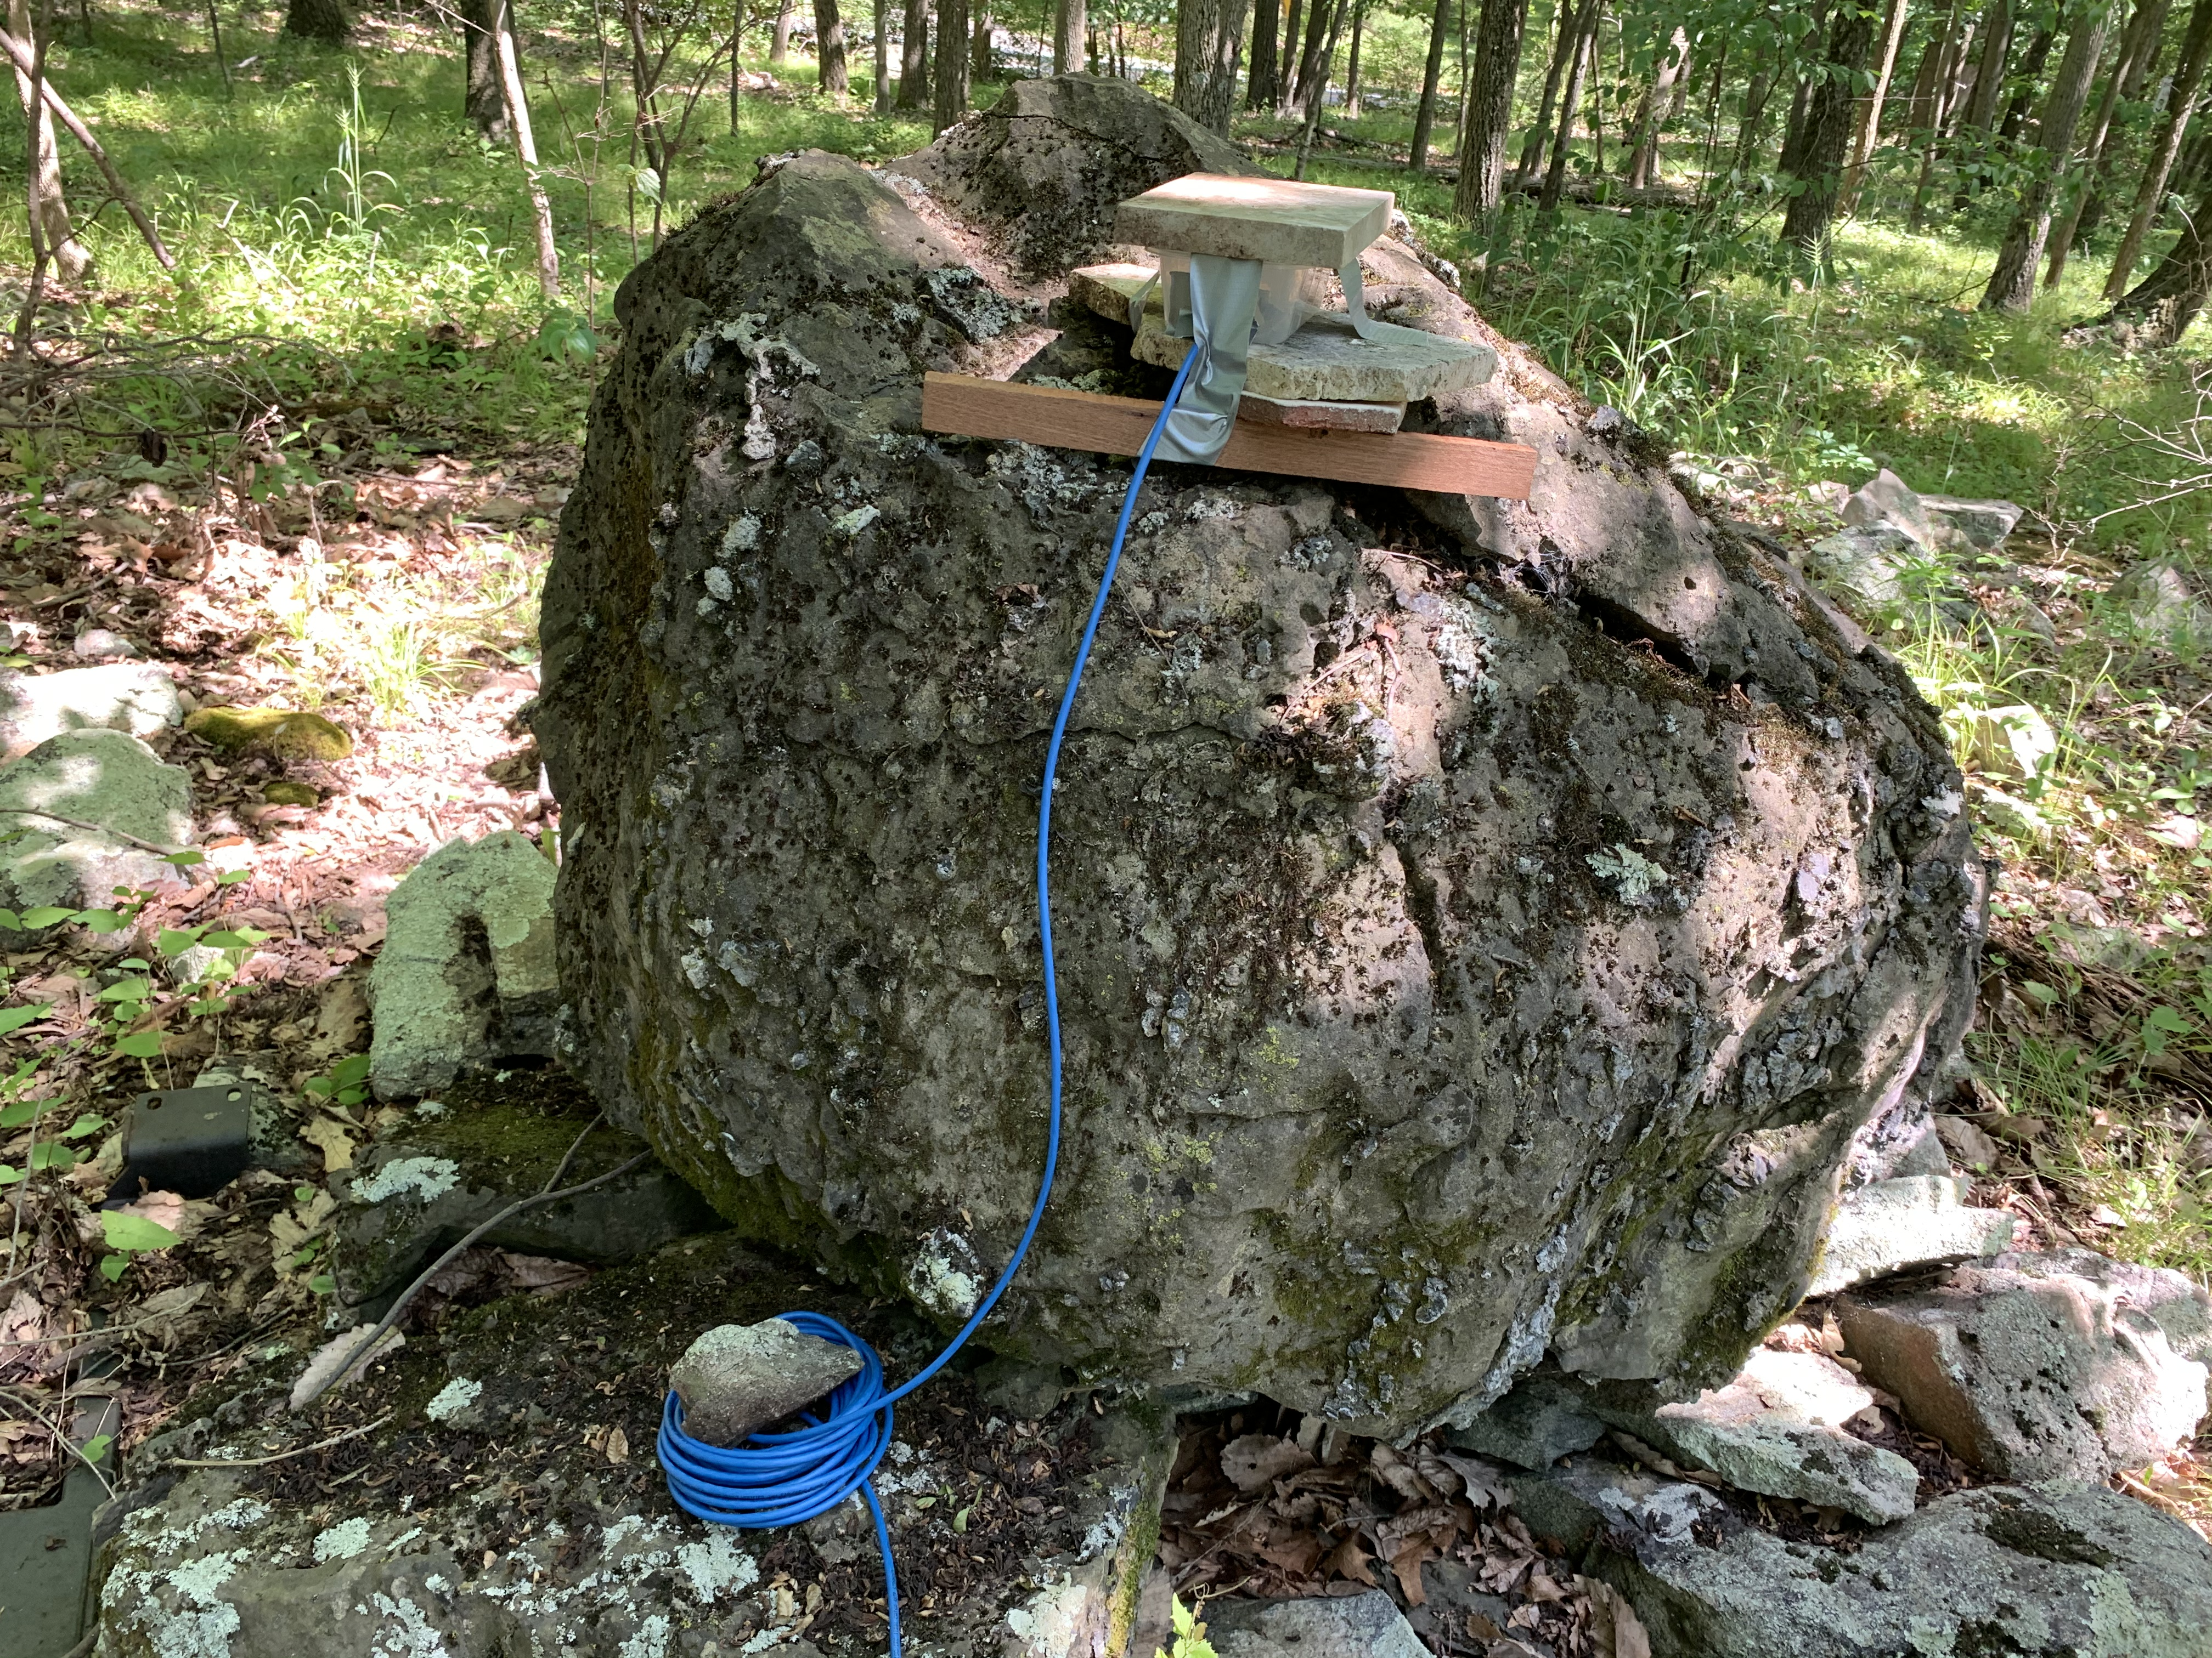
Overview
The prototype RM3100 magnetometer was installed at Jenny Jump Observatory on 6/29/2020.
Data from the magnetometer are compared with data from the co-located NJIT science magnetometer.
Both data sets are 10-sec moving averaged.
It is not clear whether the RM3100 magnetometer measured magnetic fields correctly since the field tracings do not match (time stamping issue, perhaps?).

Slide 7
I2C Extender Performance
  The I2C bus provides very short range (less than 0.5 m) serial communication between components within a chassis. Single-ended signaling provides very limited noise immunity.
  PSWS and similar projects require significant separation between sensors and support electronics to achieve maximum sensitivity.
  NXP PCA9615 converts I2C single-ended to differential signaling at voltages independent of the original input. Differential signaling allows a substantial increase between the remote sensor and the data collection apparatus. Reliable operation at well over 30 m (~100 ft) was demonstrated in testing.
  The design of the I2C/dI2C bus allows attachment of additional sensors at either the local or the remote end of the bus, within the limits of available power.
  Changing the remote regulator to a very low drop out unit AND using 3.0 volts seems to have made a major improvement when coupled with in-ground temperature stabilization.
The NXP PCA9615 chips are an extreme pain to hand solder!

Slide 8
Temperature Sensitivity
PNI Sensors has stated that the sensor coils alone could have a maximum tempreture coefficient of 2nT per degree C.
Measurements made by Julius Madey on the complete 3100 board as well as the information provided by Dave McGaw's quick test indicate 7-10 nT per degree C for the complete assembly.
temperature is an important parameter.
We are currently assuming measured temperature stability of better than 1 degree C over 24 hours.
This finding motivates exploration of in-ground deployment.

Slide 9
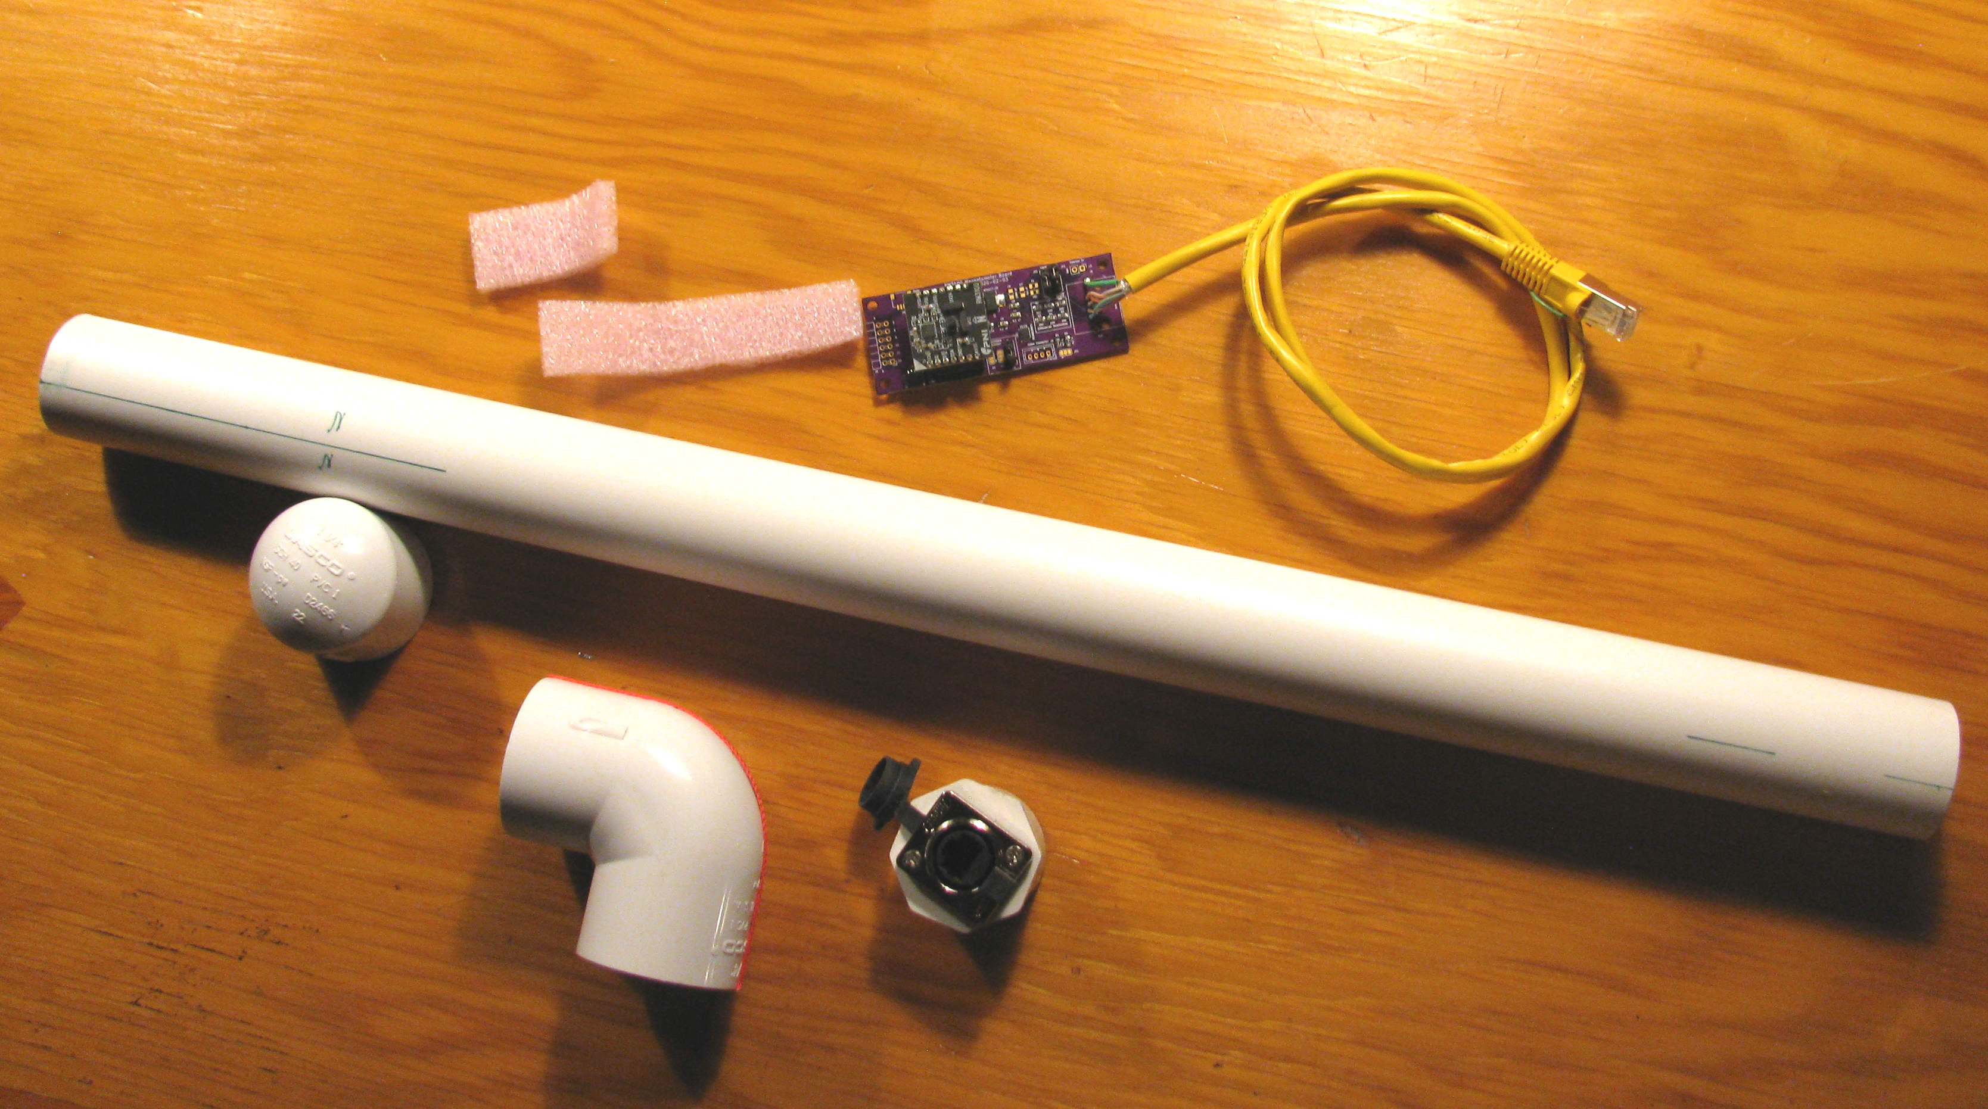
Buried Sensor

Slide 10
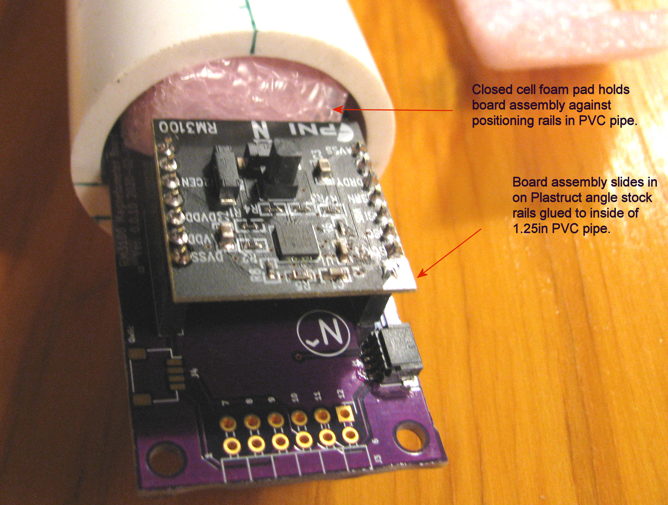
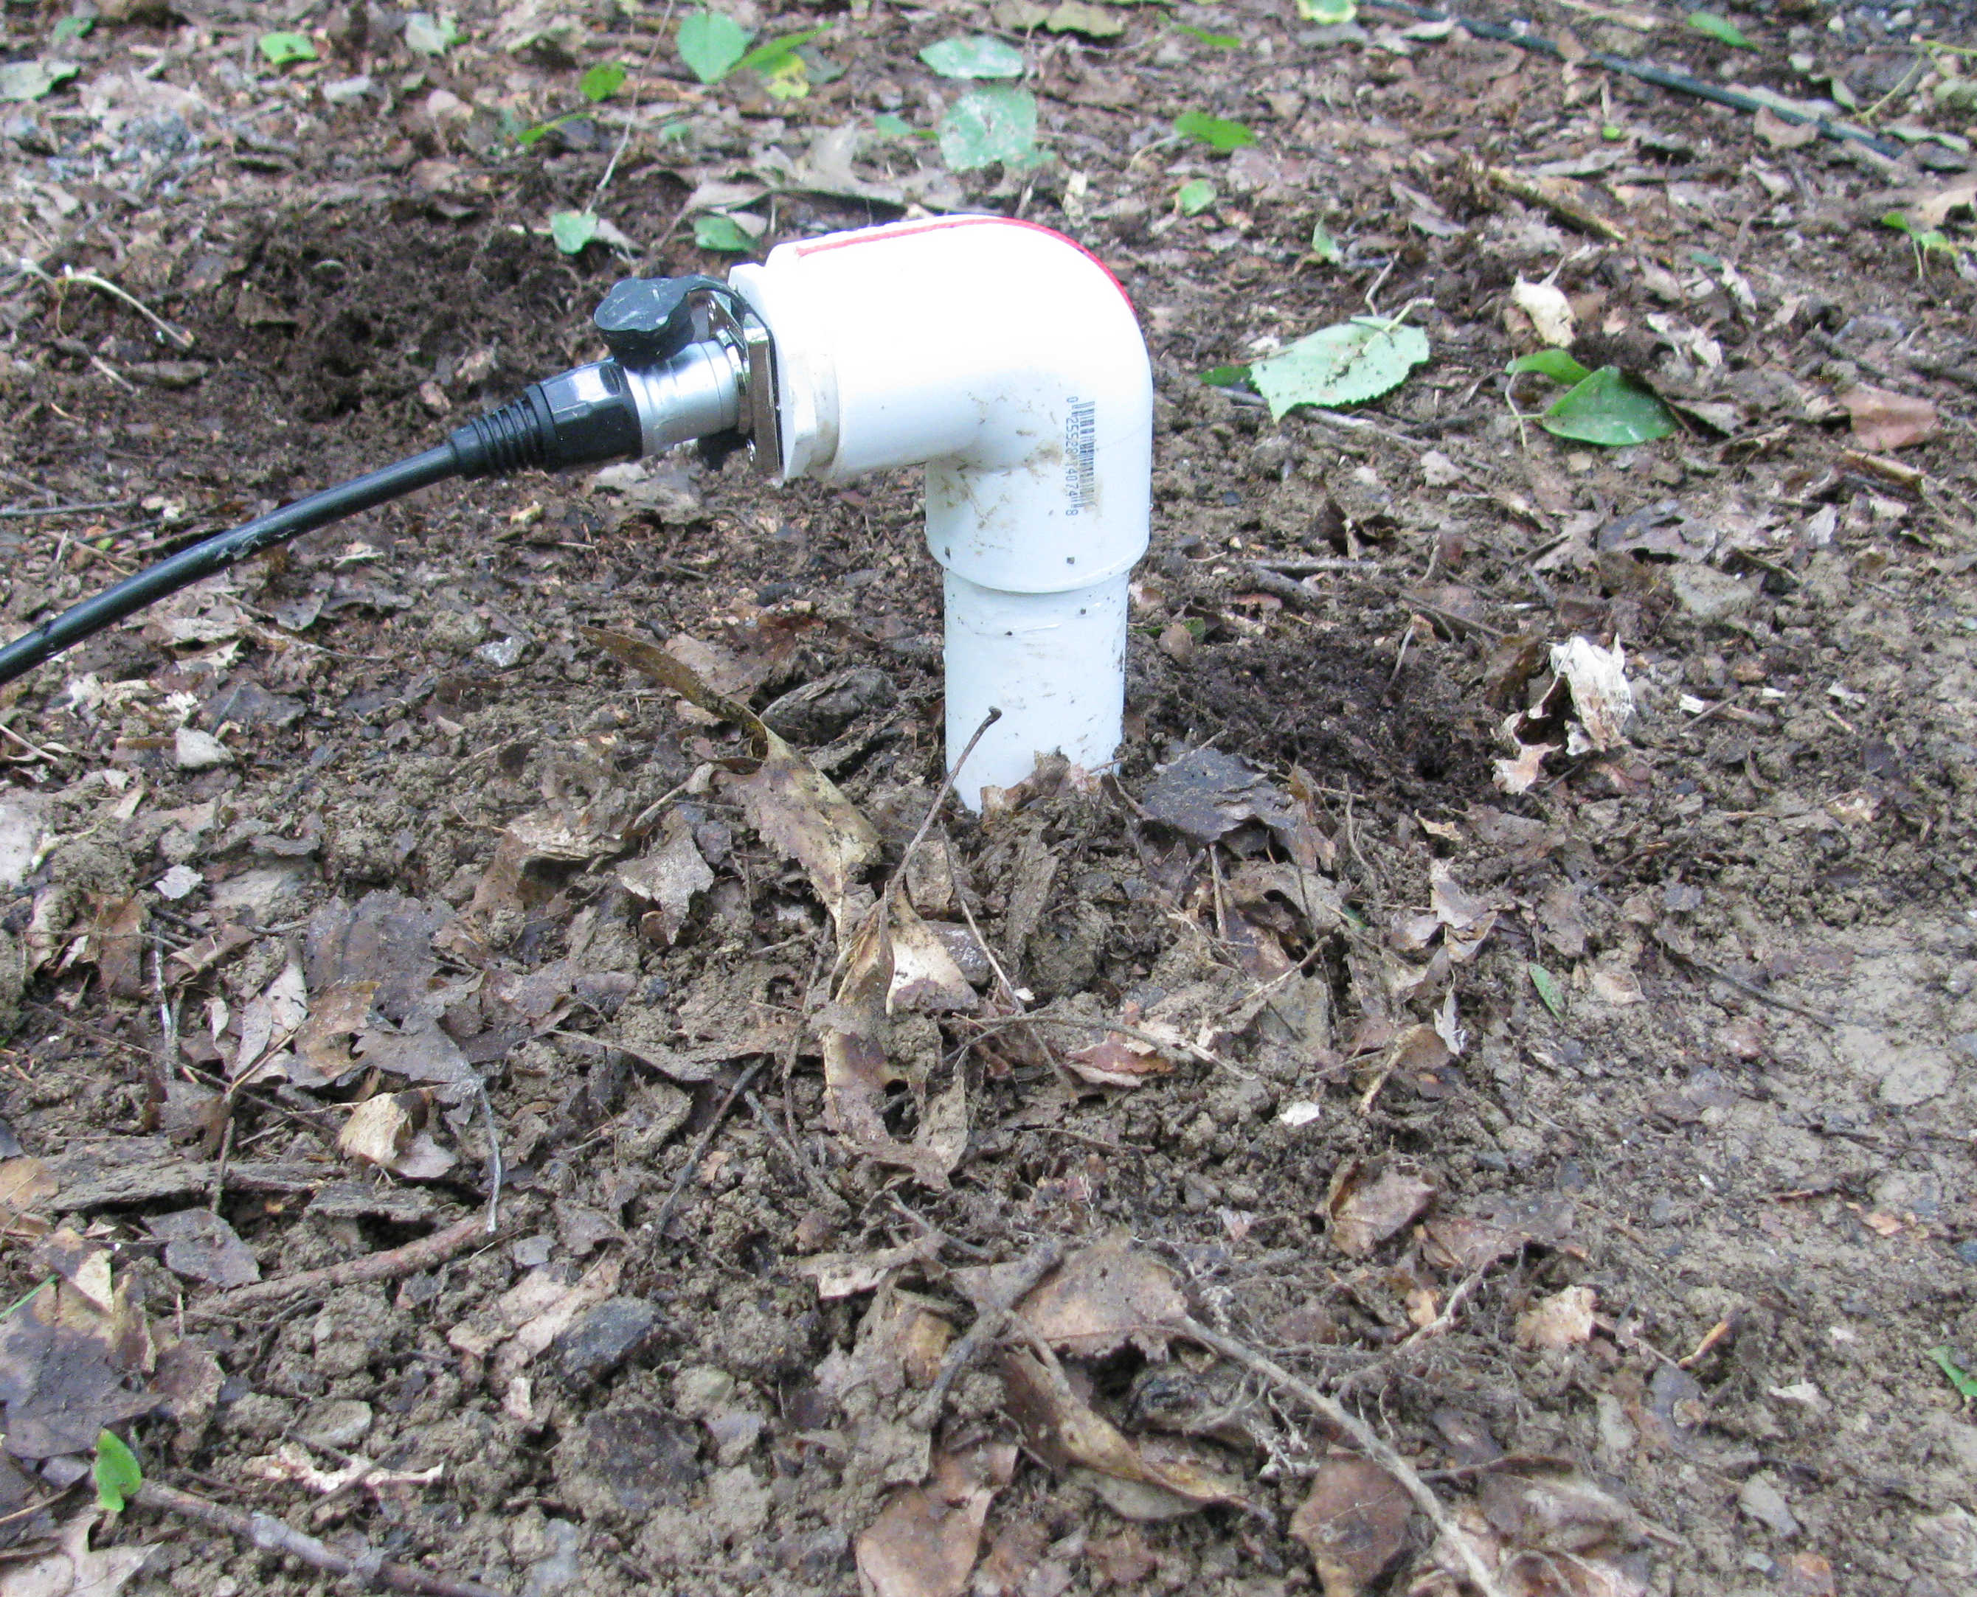
Sensor Assembly and Placement

Slide 11
Next Steps
Software driver development
  Refine and revise to support testing of production prototypes boards.
  Port to Python from C.
  Eventual integration into the larger data collection environment if desired.
  Further evaluation under realistic conditions
  Testing at more established quiet sites.
  More comparisons with calibrated sensors of established quality.

Slide 12
Conclusions: Critical Parameters
Sensitivity: The PNI RM3100 can provide provide around 10 nT of of sensitivity if carefully deployed.
Noise: Measurements are susceptible to corrupting influences (ie electric deer fences) but with thoughtful site selection and positioning remote to interferers, seems capable of producing useful data.
Accuracy: Initial tests produce show good correlation with one standard magnetometer installation (USGS Fredricksburg MD). Some divergence form another (Jenny Jump NJ, NJIT) remains unexplained.
Improvised Hemholtz coil measurements suggest that the RM3100 field data is good to at least 5%. Tests with traceable standards are anticipated soon.
Packaging: Current indications are that significant protection from temperature shifts and other hazards are provided by below ground installation.

Slide 13
References
PNI Sensor RM-3100 User manual – downloadable from:
https://www.pnicorp.com/download/rm3100-user-manual/

