Slide 1

QMesh: A long-range, low-cost wireless mesh network for digital voice communications
Dan Fay, KG5VBY
TAPR DCC 2020
Notes:
Hello, my name is Dan Fay, my callsign is KG5VBY, and I will now be presenting
“Qmesh: A long-range, low-cost wireless mesh network for digital voice communications.”

Slide 2
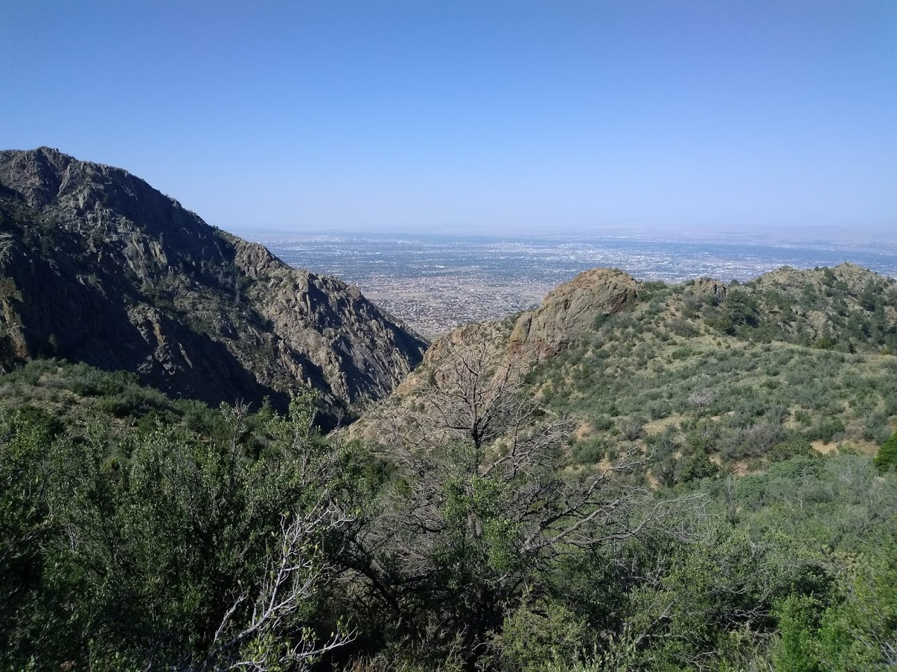
Who am I?
Licensed radio amateur since September 2017, callsign KG5VBY
  Special event communication
  Packet radio/digital communications
Presented at TAPR DCC 2018 the paper “Beyond Line-of-Sight UHF Digital Communications with the LoRa Spread Spectrum Waveform”
La Luz Trail Run 2018
Notes:
Who am I?
I’ve been a licensed radio amateur since September 2017, my callsign’s KG5VBY. My main interests in amateur radio are special event communication, such as providing communication support for different distance running events such as the La Luz trail run that’s depicted here. I am also interested in the packet radio/digital communications side of amateur radio.
At the 2018 TAPR DCC, I presented a paper entitled “Beyond Line-of-Sight UHF Digital Communications with the LoRa Spread Spectrum Waveform”. This paper explored using LoRa on the 70cm band at higher transmit power (roughly 25W) and high-gain antennas to achieve long-distance communications via diffraction and troposcatter. The work demonstrated successful beyond-line-of-sight communications at nearly 125 miles. This distance set a ground-to-ground distance record for LoRa communications.
For this talk, I am going to discuss a project inspired by this work, where I leverage many of the features of LoRa to develop a mesh network that will allow for relaying voice data across multiple wireless devices.

Slide 3
What is QMesh?
It’s another MANET/wireless mesh network protocol
What makes it unique
  Isochronous -- can handle streaming data like voice
  Self-healing/self organizing
Relatively low datarate (at most 10’s of Kb/s)
  Enough to support vocoded voice (700bps-1600bps)
  Can also carry small amounts of data (location, telemetry, etc.)
Uses the LoRa Chirp Spread Spectrum (CSS) waveform
  Provides better Eb/N0 than “standard” modulations (FSK, PSK, etc.)
  Unique properties of the LoRa waveform (spread spectrum, low symbol rate) enable QMesh to work
Notes:
QMesh is yet another low-power wireless mesh protocol. Yes, there’s many others out there.
What makes it unique is that, unlike the other common wireless mesh network protocols out there, this one is designed for more than just small bursts of telemetry data. It’s designed to support streaming data, including and especially vocoded voice.
The protocol is relatively low datarate, supporting at most a few tens of kilobits per second. While this isn’t much, it’s enough to support vocoded data, which uses a maximum of around 3k-4kbits/s. While the primary use case is for vocoded data, Qmesh also supports moving small amounts of data such as location, telemetry, text messages, etc.
Qmesh is based on a specific waveform, the LoRa Chirp Spread Spectrum waveform. At a given power level, LoRa provides better range at a given bitrate than other modulations such as FSK. LoRa’s spread spectrum properties are utilized by Qmesh to enable its isochronous protocol to work.

Slide 4
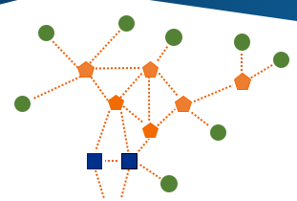
MANETS/Wireless Mesh Networking
MANET = Mobile Ad-Hoc NETwork
  Self-assembling
  Self-healing
Mesh networking
  Nodes relay packets until they reach their destination
  Two major types: routed and flooded
Source: https://blog.particle.io/2018/04/28/how-to-build-a-wireless-mesh-network/
Notes:
Here is an overview of MANETs and wireless mesh networking.
MANET, which stands for Mobile Ad-Hoc Network, describes a network where nodes can arbitrarily join and leave. Key aspects of MANETs are their ability to self-assemble, where new nodes can quickly join and communicate with other nodes on the network, and self-heal, which means the network can continue to function with nodes leaving the network.
Mesh networking is a non-hierarchical type of networking where nodes relay data until it gets to its destination. There are two major types of mesh networking: routed and flooded.

Slide 5
Flooding vs. Routing
Routing
  Nodes repeat packets if they’re along a route to the packet’s destination
  Doesn’t retransmit if it doesn’t move the packet closer to its destination
  Relatively complicated due to need to (re)discover and (re)build routes
Flooding
  A node repeats every packet it receives
  Provides redundancy
  Self-healing, nodes can freely join and leave without any other communications needed
  Can be inefficient vs. routing
  Good for multicast (e.g. PTT voice, tracking telemetry of team members)
  Susceptible to the Broadcast storm problem
Synchronized Flooding (what QMesh uses)
  Nodes repeat packets at the same time
  Good for streaming (isochronous) voice
  Colliding packets could be a problem
Notes:
In routed mesh networks, nodes repeat data along a predetermined route. For node-to-node communications, this is more efficient, as it eliminates redundant communications. It also can increase the aggregate capacity of the network, as multiple nodes can communicate different data at the same time. A major challenge with routed networks, especially in the context of MANETs, is building and re-building routes as nodes enter and leave the network. For large hop counts (e.g., six or more), building routes can become intractable. Building and rebuilding routes typically requires additional mesh network traffic to allow nodes to discover their neighbors in order to keep their routes up to date.
In flooded mesh networks, every node repeats every message it receives. Doing this vastly simplifies conveying data to its destination, as there is no need to constantly discover and rebuild routing tables. As a result, self-healing is straightforward to implement. Another benefit it provides is that the redundant communications provides “backup” communications that can improve reliability.
While flooding is good for multicast and other one-to-many communications, it is inefficient for point-to-point communications.
Mesh networks can implement both protocols at the same time. Many times, flooding is used for e.g. broadcast and node discovery messages, while routing is used to move specific data between nodes.
A major problem with flooding (and routing in some cases) in wireless mesh networks is known as the broadcast storm problem. In the broadcast storm problem, multiple nodes try to communicate at the same time, causing their communications to destructively collide with each other. After collision, the nodes attempt to retransmit the data, and once again destructively collide. This process of nearly-endless collision and retransmitting causes lots of wireless traffic but little actual communication to occur.
Qmesh uses synchronized flooding along with some LoRa-based waveform tricks to mitigate the broadcast storm technique. In synchronized flooding, each node repeats a received data packet at a specific time, in this case, all nodes repeat the received packet at the same time. Besides providing a way to mitigate the broadcast storm problem (which I will discuss later), it also provides a way for the low-latency streaming bandwidth needed for real-time voice.

Slide 6
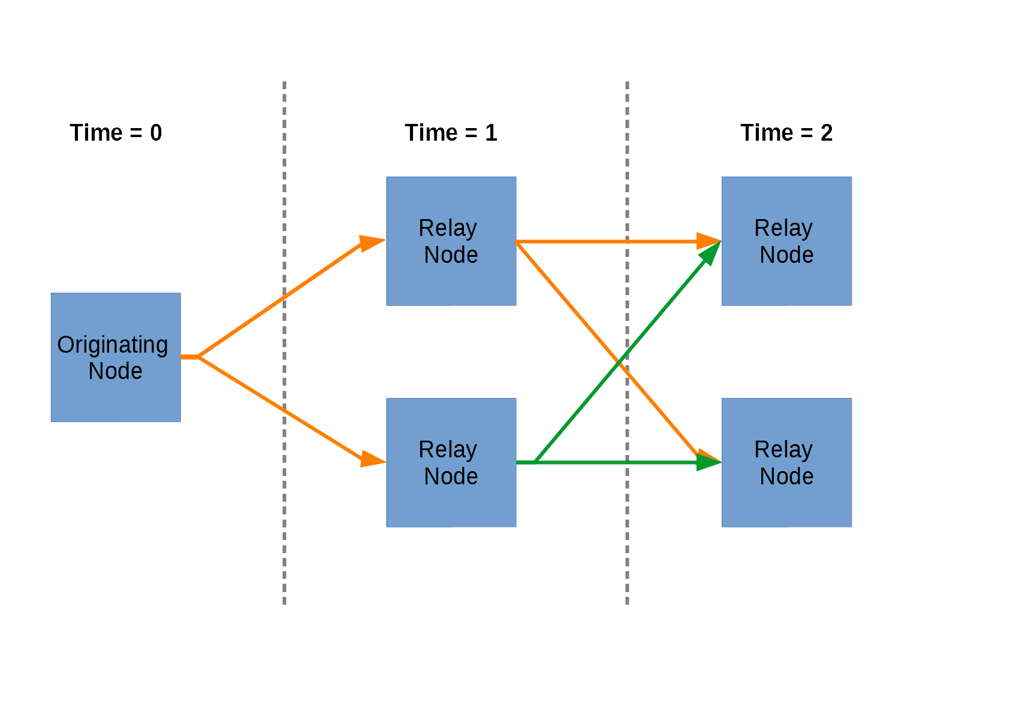
Synchronized Flooding Example
Notes:
This slide shows an example of synchronized flooding.
At time=0, the originating node produces a packet. This packet is received by the two adjacent nodes. At the next time interval, these nodes will simultaneously retransmit the received data, which will then in turn be received by the final nodes. These nodes will then repeat the packet at the subsequent time interval.

Slide 7
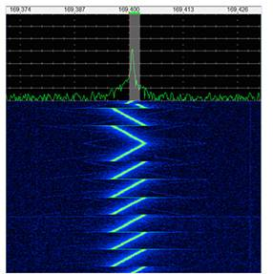
LoRa
LoRa is Semtech’s proprietary implementation of Chirp Spread Spectrum (CSS)
  Targets battery-powered, Internet-of-Things (IoT) devices
  Used to implement LPWAN protocol LoRaWAN
Benefit: CSS gives large processing gain vs. FSK/OOK
  LoRa@1172bps: -132dBm Rx sensitivity on 70cm
  FSK@1200bps: -123dBm Rx sensitivity on 70cm
  LoRa supports bitrates up to 37500bps (62500bps on newer chipsets)
Highest sensitivity rate possible for LoRa is -148dBm
  Not used much because it requires a TCXO to function
  Low data rate -- 18bps at this sensitivity level
LoRa is becoming increasingly popular, so products are easy to find
  HopeRF is a popular module maker; some integrated w/MCU emerging
  33cm and 70cm modules easy to find
  LoRa chipsets support 137MHz through 1GHz, as well as the 2.4GHz band
LoRa provides large sensitivity improvement (9dB or more) vs. FSK
Source: https://www.digikey.com/en/articles/techzone/2016/nov/lorawan-part-1-15-km-wireless-10-year-battery-life-iot
Notes:
Now, time to provide a background on LoRa.
LoRa is Semtech’s proprietary implementation of Chirp Spread Spectrum (CSS). LoRa is designed for low-power, Internet-of-Things-like devices, such as wireless sensor nodes. The most common use of LoRa is to implement the Low Power Wide Area Network protocol called LoRaWAN.
A major benefit of LoRa’s chirp spread spectrum is that it provides additional processing gain vs. other modulation forms such as FSK and PSK. As an example, at roughly 1200bps, LoRa enjoys a 9dB receive sensitivity improvement versus FSK. Depending on the specific LoRa chipset used, LoRa can support bitrates of up to 62500bps.
In terms of product support, LoRa is becoming increasingly popular as the LoRaWAN LPWAN standard becomes more popular. Many companies make LoRa modules for integration into other designs. The most commonly-supported amateur radio bands are the 33cm band and 70cm band.

Slide 8
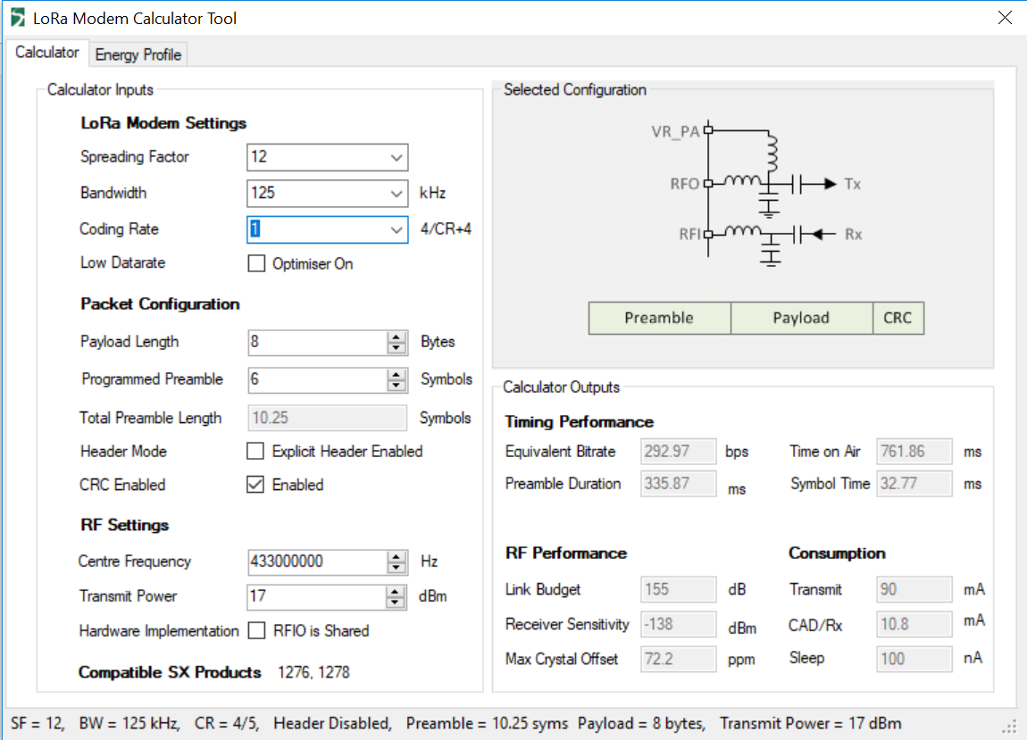
LoRa Parameters
Spreading Factor (SF)
  2^{SF} = number of chips/symbol
  Higher SF gives higher Rx sensitivity in exchange for lower data rates
  Different SF’s are somewhat orthogonal, as well as different IQ polarities
Bandwidth – how “wide” the chirp is
  Wider bandwidth gives higher data rates at expense of Rx sensitivity
  500KHz, 250KHz, and 125KHz are typically used
Coding Rate specifies the FEC (Hamming code)
Notes:
LoRa communications can be parameterized along three major degrees of freedom.
The first one is the Spreading Factor. Each chirp is comprised of a series of very short tones, called chips. The number of chips per chirp is equal to two to the power of the spreading factor.
Higher spreading factors gives higher Rx sensitivity at the expense of a lower data rate.
The next LoRa parameter is the modulated bandwidth. LoRa allows for bandwidths ranging from up to 500KHz all the way down to 7.8KHz. As expected, narrower bandwidths improve receive sensitivity at the expense of bitrate.
The final major parameter is coding rate, which specifies how many redundant bits to use for error correction.

Slide 9
The (FM) Capture Effect
Many types of receivers receive exclusively the strongest signal when that signal is stronger (by 3dB or more) than other signals
  Necessary for e.g. Wi-Fi, Bluetooth, etc. for coexistence with other transmitters in the area
  Constant-envelope modulation schemes (FM, FSK, some PSK, etc.) are most well-known for the capture effect
  AM and SSB receivers do not experience capture
Effect observed when two people try to transmit into same FM repeater
  Almost always, one person is heard
  Other person(s) comes off as some sort of distortion/noise
LoRa is a constant-envelope modulation that does experience the capture effect
Notes:
Key to Qmesh’s protocol is the Capture effect.
The capture effect is where a receiver, upon receiving multiple simultaneous signals, only receives, or captures, the strongest signal. Receivers that capture signals are generally needed for wireless protocols that operate in unlicensed bands like Wi-Fi and Bluetooth due to the need to coexist with other transmitters in the area.
It is important to note that LoRa is a constant-envelope modulation scheme that does experience the capture effect.

Slide 10
Using the Capture Effect
Capture effect means that we can successfully receive collisions if the colliding packets are far enough apart in received power
Can leverage capture effect to make synchronized flooded protocols work without everyone interfering with each other
Tricky to do with FSK, need some sort of phase dithering with good forward error correction (need SDR or custom radio)
Easier to do with spread spectrum
  Glossy Project (academic) used DSSS in 802.15.4
  Later work has looked at doing the same with LoRa
Notes:
The capture effect means that we can successfully receive collisions if the colliding packets are far enough apart in received power. We can then leverage the capture effect to make synchronized flooding work better.
Previous work has shown that synchronized flooding with FSK can be made to work, but the performance in terms of successful packet receipt is not that great.
What does work significantly better, however, are spread spectrum techniques. The Glossy Project demonstrated that synchronized flooding can be used with the Direct Sequence Spread Spectrum implemented in the 802.15.4 PHY.
Subsequent work has demonstrated that this effect also works for LoRa.

Slide 11
Increasing Capture Success with LoRa
Basically, “spread out” the overlapping LoRa signals so they interfere less with each other
LoRa has some features we can use to increase the likelihood of successful capture
  Frequency separation between chips
  Low chirp (symbol) rate
  Tolerance of frequency error (up to +/- 25% of the LoRa bandwidth)
Randomly “wobble” the frequency
  Can put chips “between” each other
  Shift chirps around so that they don’t overlap in time/frequency
Can also shift things around by adding a timing offset
  Need to encode timing offset within the packet so that the next node can compensate
  Can’t shift timing more than half a symbol -- receiver locks onto weaker packet first, then gets drowned out by stronger packet coming in later
Notes:
LoRa has some features that can help improve capture success. Conceptually, these features involve moving around the chirps in time and/or frequency so that they overlap less with other chirps. Some of these features include:
Utilizing the frequency separation between chips.
The low chirp, or symbol rate
The LoRa chipset’s tolerance of up to plus or minus 25 percent of the modulated bandwidth.
One technique to reduce the amount of chirp overlap is to randomly “wobble” the frequency. This can help by both shifting around chirps as well as causing chips to slot in between each other.
Another way to shift around the chirps is to add in a timing offset. This requires encoding the timing offset into the packet so the next node can compensate. It is important to note that the timing offset cannot be shifted by more than half of a symbol period. This is because for larger offsets, a situation can occur where if a weaker packet comes in first, the receiver will lock onto it and the stronger packet will just create heavy interference.

Slide 12
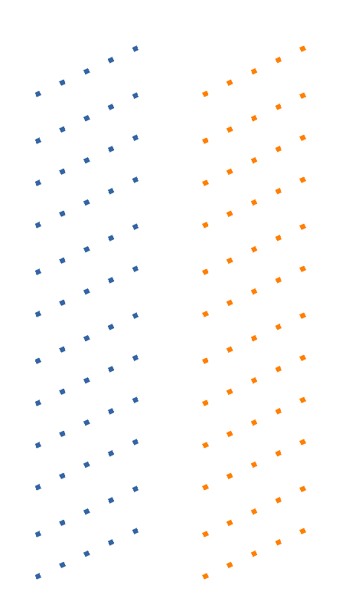
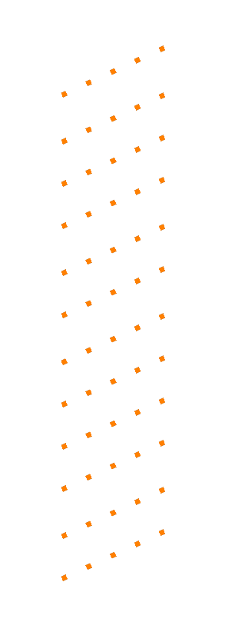
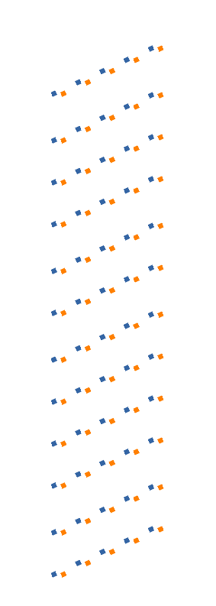
Chip-Level LoRa Overlap Reduction
Two LoRa signals on completely
Different channels
Two LoRa signals on
the same frequency
Two LoRa signals with a
very small frequency offset
Notes:
This slide illustrates the chip-level overlap reduction.
The first diagram on the left shows two LoRa signals on completely different channels, where there is no overlap whatsoever.
The second picture shows two LoRa signals that are completely overlapping.
The final diagram shows what the LoRa signals look like when there is a small frequency offset. Note that this frequency offset is quite small, typically being maybe a few tens of Hertz.

Slide 13
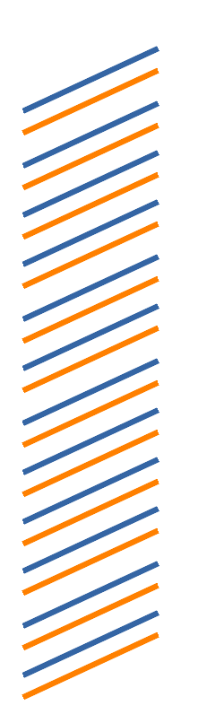
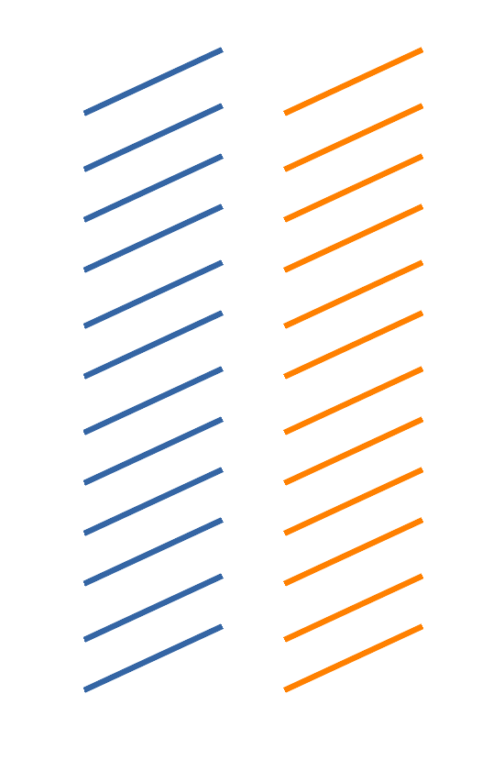
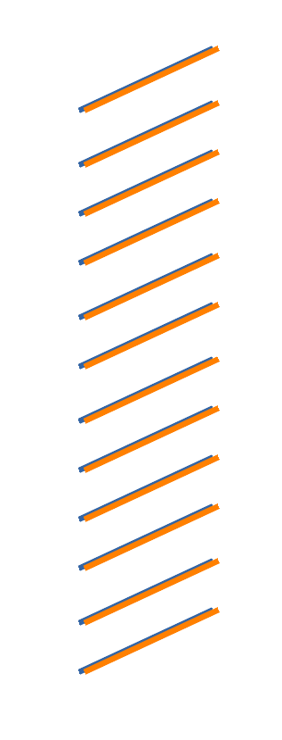
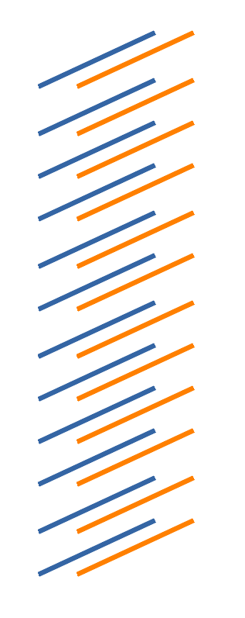
Symbol-Level LoRa Overlap Reduction
Two LoRa signals on completely
Different channels
Two LoRa signals on
the same frequency
Two LoRa signals with a
small frequency offset
Two LoRa signals with a
timing offset
Notes:
The diagrams here show the two different techniques are used to reduce symbol overlap.
The first two diagrams show completely-separate LoRa signals and completely-overlapping LoRa signals.
The next diagram shows what the two LoRa signals look like when frequency wobbling is used.
The final diagram shows what the two LoRa signals look like when a timing offset is used.

Slide 14
The QMesh Protocol Overview
Is based on TDMA (Time Division Multiple Access), with same-size time slots.
A transmitter operates at a 33% duty cycle
  Transmits a packet every third time slot (waits two timeslots before transmitting again)
A receiving node
  Decodes the packet and retransmits if appropriate
  If retransmitting, waits one timeslot before retransmitting
Time gap between receipt and retransmission
  Allows time to decode packets, including complicated forward error correction
  Gives a “second chance” to receive a packet by a node one hop downstream
Notes:
Now we can move onto describing the Qmesh Protocol itself.
Qmesh is based on a Time Division Multiple Access (TDMA)-based protocol, with each timeslot being the same length.
In Qmesh, the transmitter operates at a maximum 33% duty cycle, where the transmitter can transmit at most once every third timeslot.
When a node receives a packet, it first decodes it. If it should retransmit it, it waits one timeslot before doing so. The gap time slot serves three purposes:
The first one is to give the system time to decode (forward error correction can take a long time to decode) and process the packet.
The second one is to provide a second chance to receive the packet if there is a downstream node retransmitting it.
Finally, it reduces collisions between nodes.

Slide 15
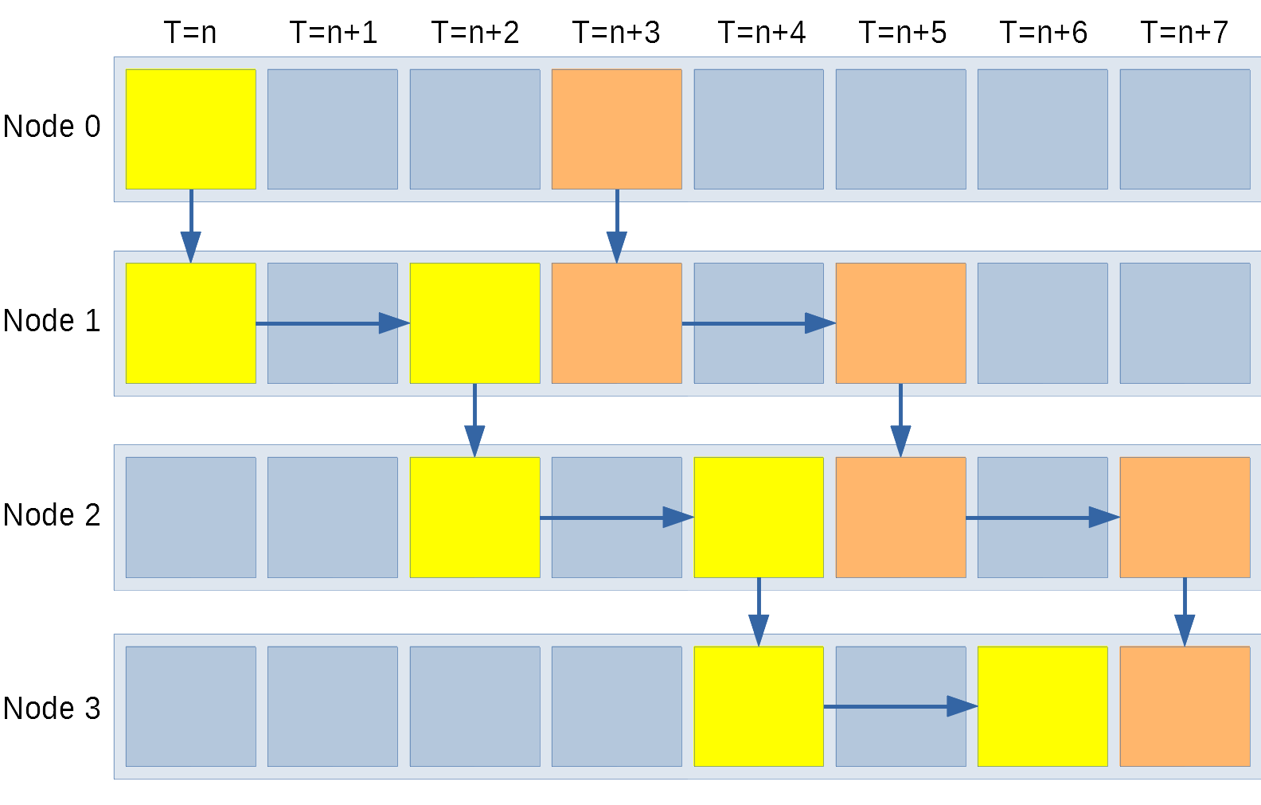
QMesh Protocol In Action
Notes:
The above diagram shows the Qmesh protocol across time.
Node 0 first transmits a packet. It gets received by Node 1. Node 1 decodes and retransmits the packet at n+2. Node 2 receives the packet at n+2 and retransmits it at n+4. Finally, Node 3 receives the packet, waits one timeslot, and then retransmits it.
Next, at n+3, Node 0 originates another packet. This packet goes down the line in a similar fashion.
You can also see here the “second chance” feature of the TDMA protocol. For example, if Node 1 does not receive the packet from Node 0 at the first timeslot, it has a second chance to receive it from Node 2 at n+2.

Slide 16
Forward Error Correction (FEC)
LoRa has a very simple, Hamming Code-based FEC built into it
Can likely gain at least a few dB of performance with a decent FEC
  Theoretical gain may be 2-10dB of coding gain in an AWGN channel (Additive White Gaussian Noise – free space line-of-sight)
  Possibly even better in multipath-heavy situations
  Substantial benefits in a collision-heavy environment
Currently using Reed-Solomon-Viterbi (RSV) coding
  Using libcorrect, which is a simplified port of Phil Karn KA9Q’s libfec
  ½ rate (encoded with twice as many bits as the original data)
  Constraint length = 7 used
  8 additional bytes for Reed-Solomon outer code
Hard decoding – may be possible to extract soft decoding information from radio in the future
Notes:
The next key feature of Qmesh is the use of sophisticated Forward Error Correction. While LoRa has a form of FEC built into it, this code is limited in its ability to correct errors as compared to more sophisticated algorithms.
A better forward error correction algorithm can bring several benefits to Qmesh. The first, and most obvious one, is that it can improve the effective link budget of the Qmesh system, allowing for longer range. The second, and more important benefit of forward error correction for Qmesh is that it helps improve the packet receive rate in the presence of heavy interference, such as the interference caused by multiple nodes transmitting at the same time.
Qmesh is currently using a Reed-Solomon-Viterbi error correction algorithm. Reed-Solomon-Viterbi combines a convolutional code with a Reed-Solomon code.
The forward error correction algorithm currently used by Qmesh use hard decoding, as the LoRa radio does not provide soft bits in any sort of straightforward manner.

Slide 17
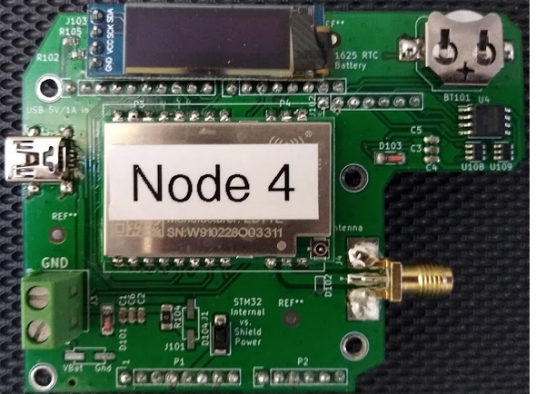
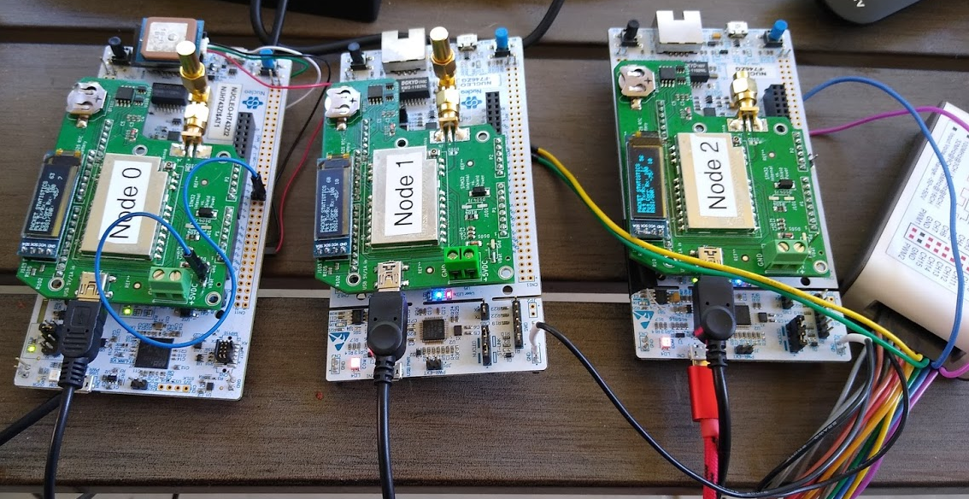
QMesh Test Node
LoRa Shield + STM32 NUCLEO-144 Board
USB on the shield (black cable) supplies power to both boards
Red USB cable connects to computer, provides debug and serial port
OLED display provides live information without needing a connected PC
Notes:
Next, I’m going to discuss the hardware used by Qmesh.
A Qmesh node consists of two parts: an STM32 NUCLEO-144 board, and a custom LoRa shield for it.
It is designed so that the two boards can be powered via a USB cable. The red USB cable seen in the lower right can be used to provide debug and the console serial port.
Finally, there is an OLED display that provides live information about the operation of the node.

Slide 18
QMesh LoRa Shield Overview
Built a custom shield for the “Zio” connector on the STM32 NUCLEO-144 board
  1W LoRa module
  128Mbit QSPI NOR flash for configuration and logging
  OLED display
  Capable of powering itself and STM32 board via USB
Uses EByte 400M30S module
  Supports 410MHz-493MHz (entire 70cm amateur band)
  Based on SX1268 LoRa radio
  30 dBm (1W) PA
  External LNA (roughly 2dB improvement in Rx sensitivity)
  TCXO
EByte also makes a pin-compatible version that supports the 915MHz/33cm band
EByte module’s output tested as clean by Sean Turner KI5CBG
  ~29-30dBm power output measured
  Spurious harmonics at least 60dB below fundamental
Notes:
The LoRa shield is a custom design that’s designed to work with the “Zio” connector on the NUCLEO-144 board.
The shield has a 1W LoRa module, a 128Mbit QSPI NOR flash chip for storing configuration and logging information, an I2C OLED display, and it it has a Mini-USB connector to supply 5V to the shield as well as the STM32 board.
The shield uses an Ebyte 400M30S module. This module is designed to operate from 410MHz up to 493MHz, which covers the entire North American 70cm amateur band. It is based on the SX1268 LoRa radio chip. It has three features that are valuable to us: a 1W power amplifier, an external LNA that improves receive sensitivity by about 2dB, and a TCXO.
Ebyte also makes a version of this module that supports the 33cm band. The final product was tested clean, with no spurious harmonics outside of regulations.

Slide 19
QMesh LoRa Shield Design
Designed in KiCAD
  Free, Open Source (FOSS) PCB design tool
  Reasonably competitive with commercial tools (Eagle, Altium Designer)
Two-layer board
  Chinese board houses will produce two-layer boards that are <10cm on a side for cheap ($5-$10 for a run of 5-10)
  Some will also populate some SMT parts for cheap
  Power/ground planes and trace routing can be tricky vs. 4+ layer boards
  Coplanar waveguide best way to do transmission lines on the board
Lots of power decoupling capacitors
Ample ESD protection on data lines, power, and RF
Notes:
The LoRa shield board design was done in KiCAD.
It’s a two-layer board, that was fabricated and partially populated at JLCPCB. JLCPCB populated the board with everything except the pins, LoRa module, USB socket, OLED display, and SMA connector. The RF signals were done as a coplanar waveguide, as microstrip transmission lines can be tricky to design with a two-layer board.
Lots of power decoupling capacitors and ESD protection diodes are added to help add robustness and protection to the design.

Slide 20
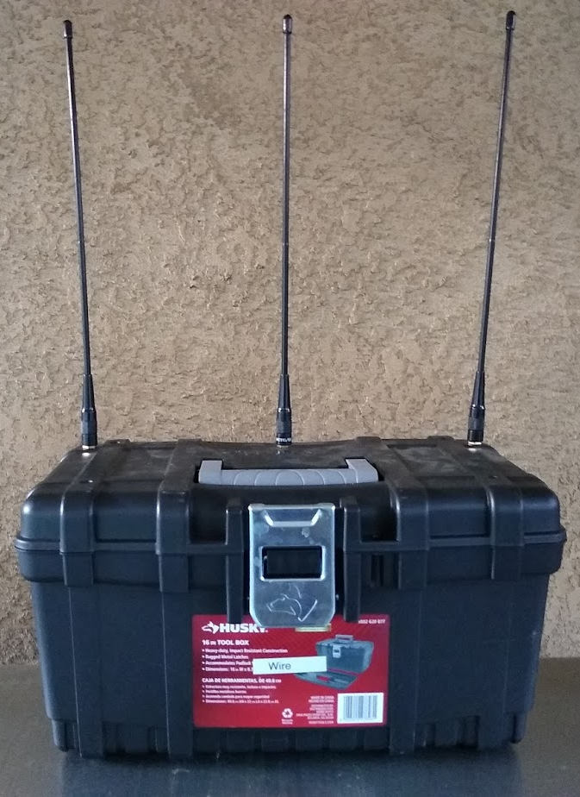
Node Configuration
24 bytes packet size, header+payload
51 bytes total coded data
BW=250KHz, SF=9, CR=0*
Originator node at minimum Tx power (0dBm into PA) transmitting through a dummy load
Other nodes transmitting at maximum power
  20dBm into PA, ~1W output
  2m/70cm HT whip antennas
Testing collisions
  Worst case scenario for interference
  Antennas are ¼ wavelength apart
Notes:
Next, I’m going to talk about the experimental setup. To test how well Qmesh can successfully receive multiple retransmitting nodes, a worst-case test scenario was built, as shown in the picture.
The worst-case scenario here is to have three nodes retransmitting close together with the same type of antenna gain, polarity, etc. By putting three identical antennas roughly one-quarter wavelength apart, the worst case retransmit scenario here should be realized.
Determining the packet receive rate was done by having another node receive the packets as I walked around my backyard with it. This helps test Qmesh’s ability to receive colliding packets in a variety of multipath fading scenarios.

Slide 21
Discussion
When FEC is used, PRR is 99%+ for one, two and three node setups
FEC seems to make a big difference here
  One node has 99%+ PRR w/o FEC
  Two nodes has ~93% PRR w/o FEC
  Three nodes has ~90% PRR w/o FEC
Appears the raise the noise floor
  Weak signals do not get received
Notes:
The final results are fairly straightforward to explain.
When Forward Error correction is used, the one, two, and three node setups enjoy a packet receive rate of 99% or more.
Without forward error correction, we see a significant, steady decrease in the packet receive rate as more retransmitting nodes are added.
It also appears that the effective noise floor is raised, and weak signals are not received as well.

Slide 22
Next Steps – FM Micro-Repeaters
Develop small FM repeaters that encode/decode voice as codec2 and use QMesh as a backhaul
  Compact, can run off solar power
  Easy to stand up a series of linked repeaters
  Can also be used to extend coverage of existing repeaters
Big benefit is accessibility
  People can use their existing radios, so can benefit from QMesh without having to design special radios
  Less hardware needed by users to benefit from QMesh
Notes:
The next step is to develop FM micro-repeaters that encode and decode the analog FM voice as codec2 and relay it between other Qmesh nodes.
These FM micro-repeaters make it easier to use Qmesh, as they allow people to use their existing FM radios with Qmesh. It also provides the opportunity for interfacing with existing FM repeater systems to extend coverage.

Slide 23
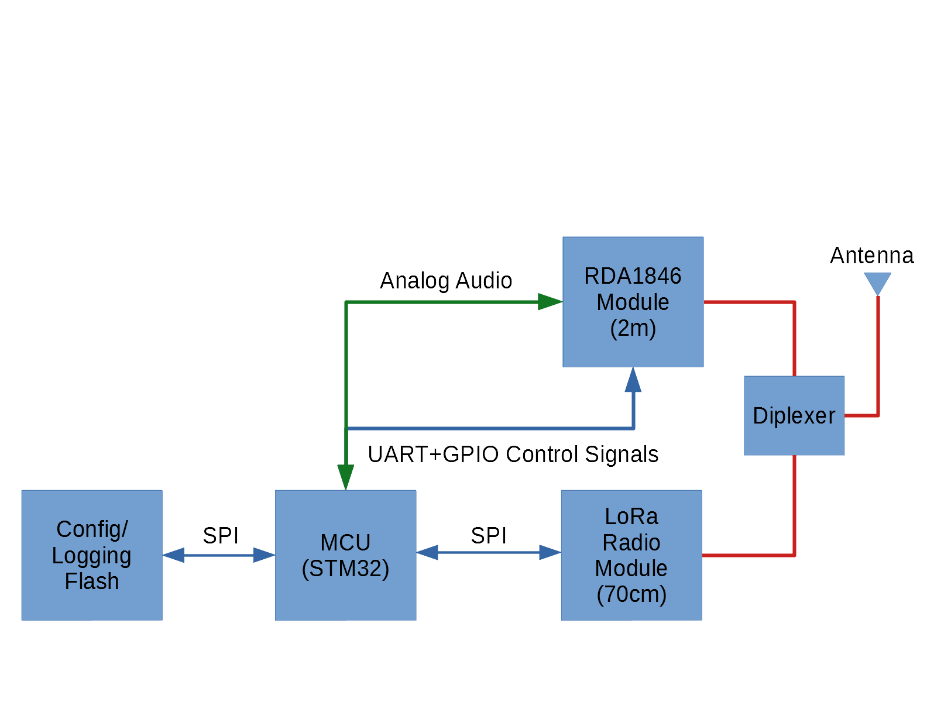
LoRa + Analog FM Architecture
Notes:
Above is an overview of the architecture of the FM micro-repeaters.
The micro-repeaters supplement the Qmesh node with an RDA1846S module. The MCU provides commands to the RDA1846S module over a UART, along with analog audio going in both directions.
A 2m/70cm diplexer is used to allow the 2m analog FM communications from the RDA1846S module to be shared with the 70cm LoRa module.

Slide 24
Contact Info
QMesh project
  Github: https://github.com/faydr/QMesh -- source code
  Hackaday.io: https://hackaday.io/project/161491-lora-based-voice-mesh-network – project overview
Blog: https://faydrus.wordpress.com (describes a lot of my radio/maker experiments)
E-mail: Daniel.fay@gmail.com (kg5vby@arrl.net should also work)
Twitter: @faydrus
Notes:
Here’s my contact information. In general, the most up-to-date ways to get information about Qmesh are through the Github project page, and after that, the Hackaday page.
I’m also fairly responsive to e-mail, and periodically provide project updates on my Twitter feed.
That concludes my presentation, the rest of the time will be for additional questions.

