Slide 1
HF Propagation Measurement Techniques and Analyses
ARRL and TAPR 39th Annual
Digital Communications Conference
September 11-12, 2020 – Virtual Online
Steve Cerwin WA5FRF
WA5FRF@arrl.net
Mico, TX 78056 EL09nn
N29’ 35” W98’ 53”
Notes:
Title Slide. HF Propagation Measurement Techniques and Analyses developed for the HamSCI community to assist in ionospheric propagation studies.

Slide 2
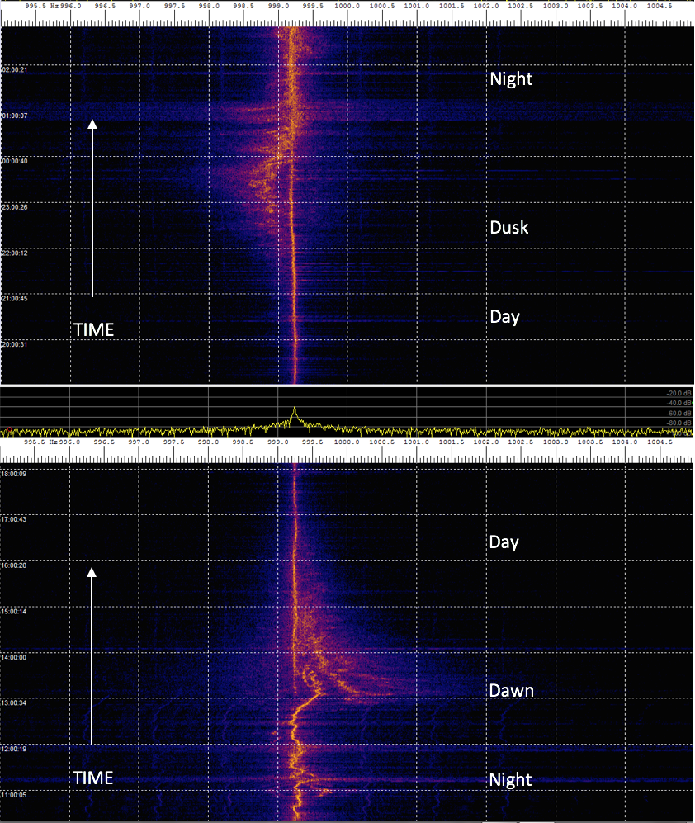
Motivation: Learn More About Ionospherically Induced Frequency Variations
On-Air Spectrograms of 5 MHz WWV Showed Smooth Daytime and Turbulent Nighttime Characteristics with a Prominent Negative Swing at Dusk and Positive Swing at Dawn. The Dawn Swing Additionally Showed Multiple Higher Order Swings, that Sometimes Manifesting Abruptly Mid-transition
1 hr.
1 Hz
Notes:
The motivation for this work was to learn more about ionospherically induced frequency variations. These spectrograms show observed frequency characteristics of 5MHz WWV during day, night, and transition periods. Typical On-Air spectrograms Showed Smooth Daytime and Turbulent Nighttime Characteristics with a Prominent Negative Swing at Dusk and Positive Swing at Dawn. The Dawn Swing Additionally Showed Multiple Higher Order Swings, that Sometimes Manifested Abruptly Mid-transition. Understanding more about this wild behavior motivated development of the analysis tools reported in this paper.

Slide 3
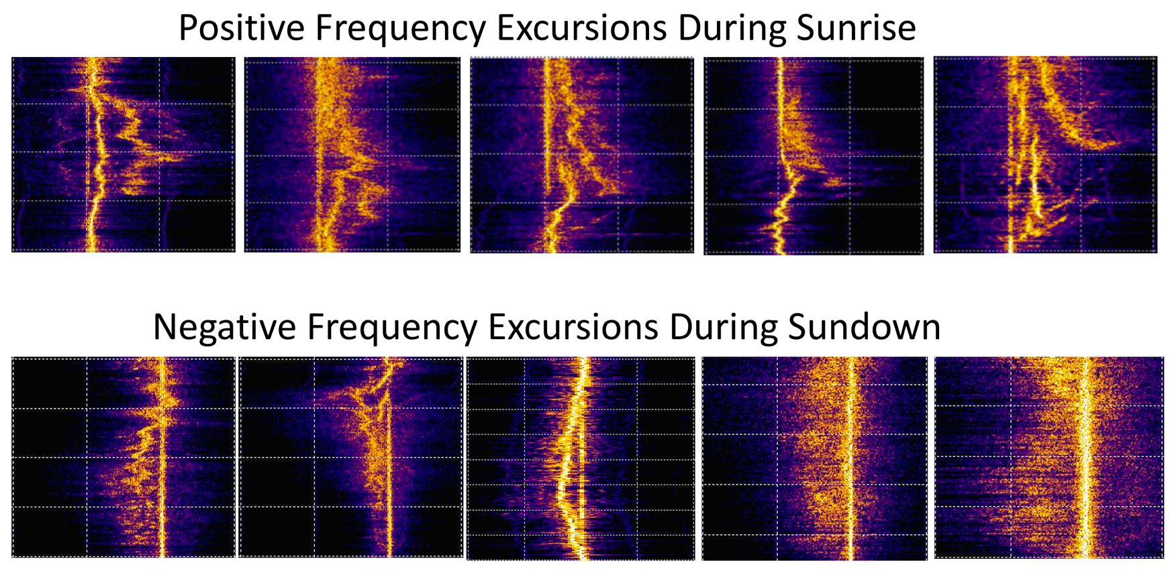
Mode Splitting Observed on WWV During Dawn and Dusk Transitions
Notes:
Here are additional spectrograms of the dawn and dusk frequency behavior. The positive dawn swings show more mode splitting and include frequency tracks that often manifest or extinguish abruptly mid-transition. The negative frequency swings at dusk are generally mode docile, probably from the moderating effect of recombination.

Slide 4
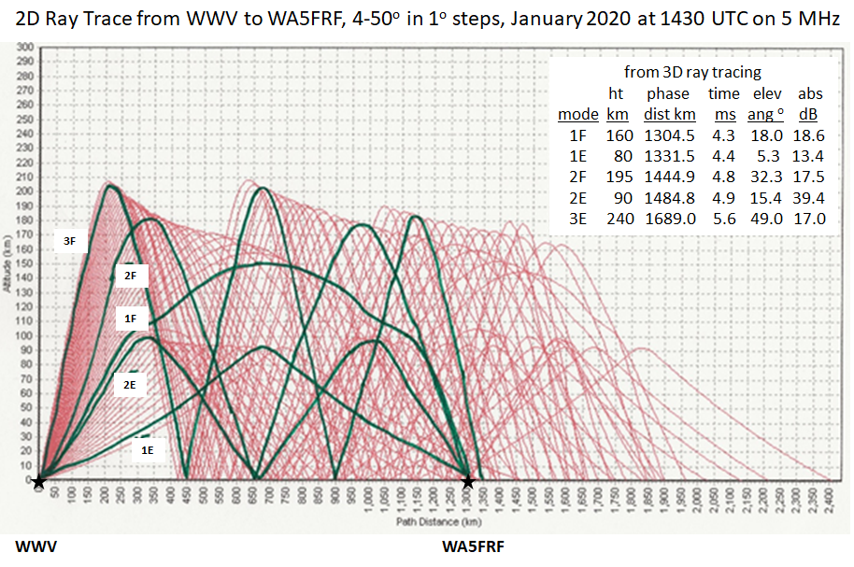
Ray Trace Simulation Predicting Multiple Propagation Modes from WWV to WA5FRF After Sunup
This is a snapshot in time. During a morning transition this pattern lowers in height and evolves in structure over time.
Postulated mode splitting mechanisms:
1. For multiple modes returning from a common layer, total path length increases according to number of hops. The longer modes close faster for a given layer descent speed, resulting in more Doppler shift according to number of hops.
2. Multiple hop modes that manifest abruptly do so when the required high angle of propagation is supported.
3. Bill Engelke AB4EJ suggested different Doppler tracks for simultaneous refractions from different layers.
4. Bill Liles WQ6Z suggested changing wave speed can be responsible for producing frequency shifts.
Simulation Provided by Carl Luetzelschwab K9LA
Notes:
This is a snapshot of predicted propagation paths from WWV to WA5FRF on a morning in January 2020. 1, 2, and 3 hop modes are possible from multiple ionization layers. During the morning transition the ionization layers lower with time in response to descending and intensifying sunlight. The lowering effective height shortens all the path lengths. The rate of path length change provides the velocity that gives rise to Doppler shifts. Several mechanisms for the observed mode splitting have been hypothesized. For refraction from the same layer, 1, 2, and 3 hop modes have path lengths that increase with the number of hops because of the extra up and down zig-zags. As the common refraction layer descends, the modes with more hops have more change in absolute distance. Since the foreshortenings occur over the same time span, the longer paths have a higher velocity of path closure. Because Doppler shift scales directly with velocity the higher order modes show more frequency shift resulting in mode splitting. Multiple hop modes that manifest abruptly do so when the ionization reaches a level sufficient to support the required high angle of propagation. Additional mechanisms have been postulated. Bill Engelke AB4EJ suggested different Doppler tracks could occur from simultaneous refractions from different layers. Bill Liles WQ6Z suggested changing wave speed can be responsible for producing frequency shifts. Indeed, an accelerating wave speed produces the same wavefront bunching as a decreasing propagation path, with indistinguishable results. Analyzing propagation with different experiments to test for things like propagation angle, skip zones, and Time of Flight can help unravel what is going on.

Slide 5
Measurement Tools and Techniques to Unravel Multiple Processes by Specific Testing
Method to obtain high resolution frequency data: offset receiver low in frequency in USB mode to down convert the RF carrier to an audio tone. This preserves small frequency variations on that can be analyzed on a sound card spectrum analyzer or an audio frequency demodulator. A GPSDO provides atomic clock accuracy and stability.
Compare simultaneous WWV spectrograms across multiple frequencies.
Compare oscillographic time domain presentations of a GPSDO stabilized tone to the down-converted WWV carrier for study of short term amplitude and frequency variations.
Measure Times of Flight of multiple modes using WWV per-second timing ticks and GPSDO synchronization to deduce propagation modes. Correlate data with ray trace simulations using actual solar-terrestrial data.
Separate simultaneous WWV and WWVH spectrogram data by deinterlacing the 500 and 600 Hz side tone encoding.
Notes:
These are some of the methods and techniques developed or used in this study. They include the method to extract precision frequency data from a receiver by down conversion of the RF carrier to an audio tone, simultaneous spectrogram recordings to look for correlations across multiple WWV frequencies, the use of oscillographic displays to study short term amplitude and frequency effects, Time of Flight measurements to deduce propagation modes, and separation of simultaneous WWV and WWVH spectrogram data by deinterlacing the 500 and 600 Hz side tone encoding.

Slide 6

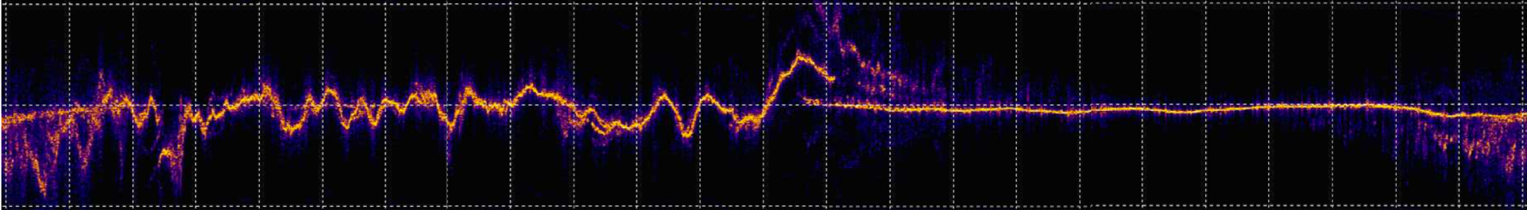
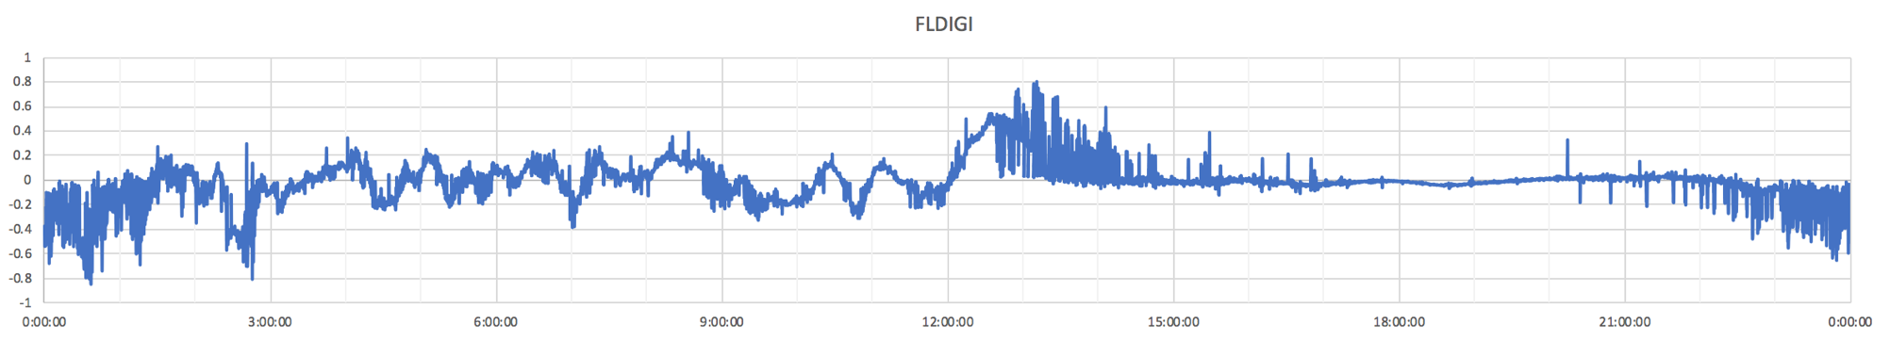
Comparison Between Spectrogram and Single Frequency Formats During HamSCI Festival of Frequency Measurements
Spectrogram Format using Spectrum Lab
Single Frequency Detector using FLDIGI
Dusk Transition ------------------ > Night --------------------------- > Dawn Transition ------------------- > Day ------------------ > Dusk Transition
Path: WWV, Ft. Collins CO to WA5FRF, near San Antonio, TX 0000z – 2359z October 1, 2019
Notes:
Here are two 24-hour recordings of 5 MHz WWV taken during the HamSCI Festival of Frequency Measurements. The top trace is a spectrogram obtained using Spectrum Lab. The lower trace is a frequency record obtained with FLDIGI. The difference is Spectrum Lab presents an FFT spectrum analysis at each sample interval whereas FLDIGI outputs only the single frequency value of the strongest signal present in each time slot. When the actual frequency track is mostly single valued, such as during the middle parts of the day and night, the two show good agreement. But during the dawn and dusk transition periods the spectrogram is clearly the better choice. It faithfully represents each frequency component present in mode splitting whereas the single frequency measurement outputs a noisy band of frequency values that results as the different amplitudes capture the FM demodulator. While the single frequency format works well for frequency measurement, an in-depth analysis of propagation phenomena requires the spectrogram format.

Slide 7
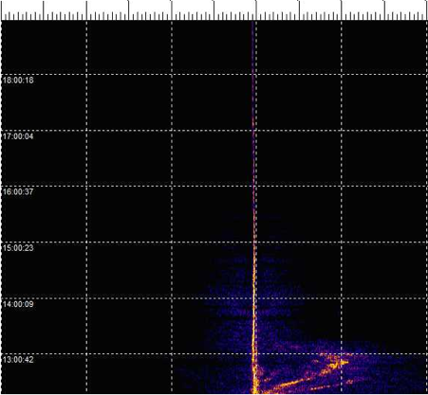
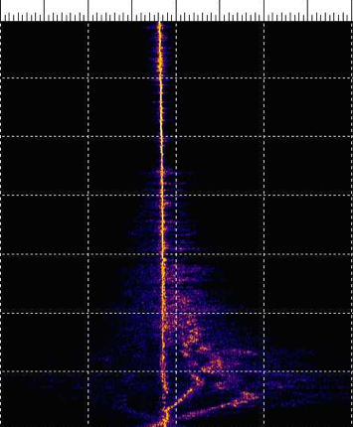
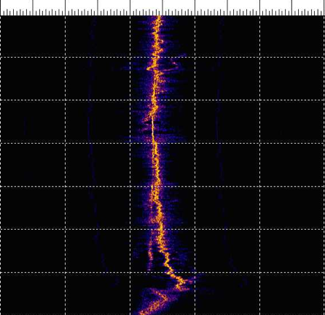
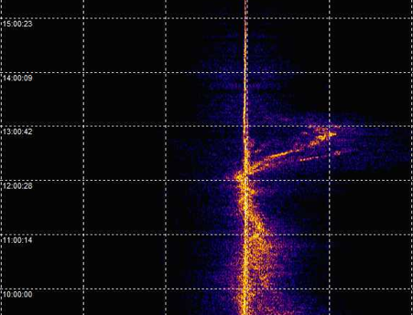
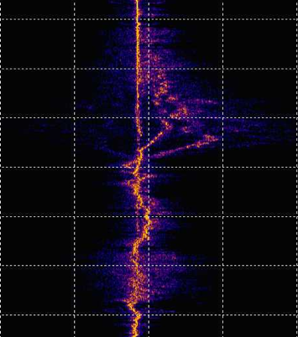
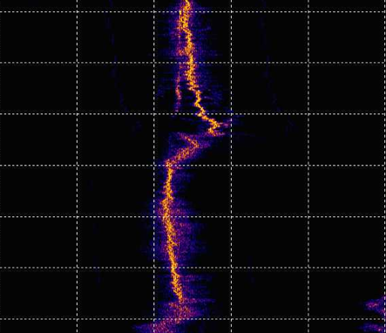
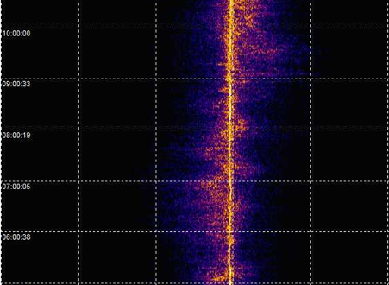
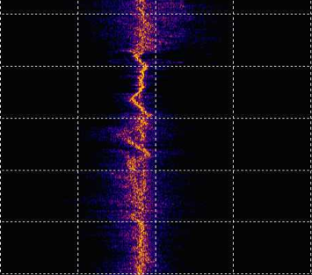
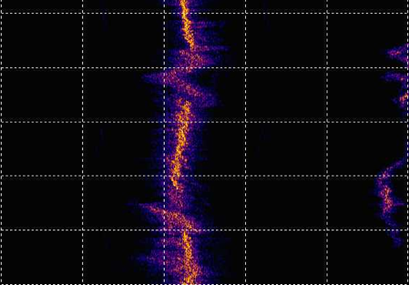
Simultaneous WWV Spectrograms at
2.5, 5, and 10 MHz During Dawn Transition
2.5 MHz
5 MHz
10 MHz
1800z
Day
1 Hz
1700z
1600z
2.5 and 5 MHz frequency steady during the day and turbulent at night. 10 MHz frequency turbulent both day and night. Only weak correlation over frequency during turbulence. The turbulence amplitude does not scale with carrier frequency.
2.5 and 5 MHz manifest multiple high order modes during sunrise but 10 MHz does not.
Some modes manifest or extinguish abruptly mid-transition.
All frequencies show a simultaneous mode showing little frequency shift.
1500z
Sunrise
CO 1306z
TX 1232z
1400z
1300z
1200z
1100z
1000z
0900z
Night
0800z
0700z
0600z
Ft. Collins, CO (40.68, -105.04) to San Antonio, TX (29.57, -98.89) on October 11, 2019
GPSDO on 2.5 MHz receiver only.
Notes:
Simultaneously recording WWV on multiple frequencies can provide insights into frequency dependent propagation effects. These three spectrograms are for WWV at 2.5, 5, and 10 MHz. The lower two frequencies were steady during the day and turbulent at night. The 10 MHz frequency was turbulent both day and night. Only weak correlations over frequency were observed during the turbulent times and the turbulence amplitude did not scale with carrier frequency. This has interesting implications for the origin of the turbulence. The 2.5 and 5 MHz frequency tracks manifest multiple high order modes during sunrise but 10 MHz does not. Some modes manifest or extinguish abruptly mid-transition. All frequencies contain a mode showing little frequency shift.

Slide 8
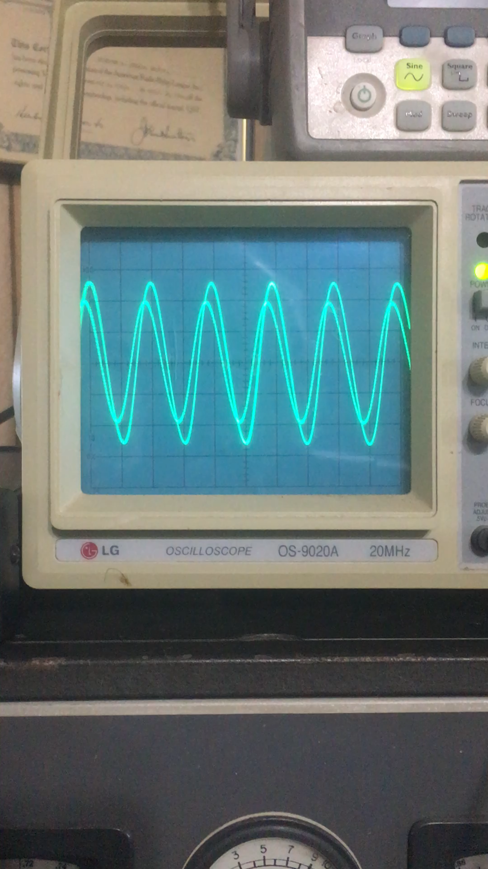
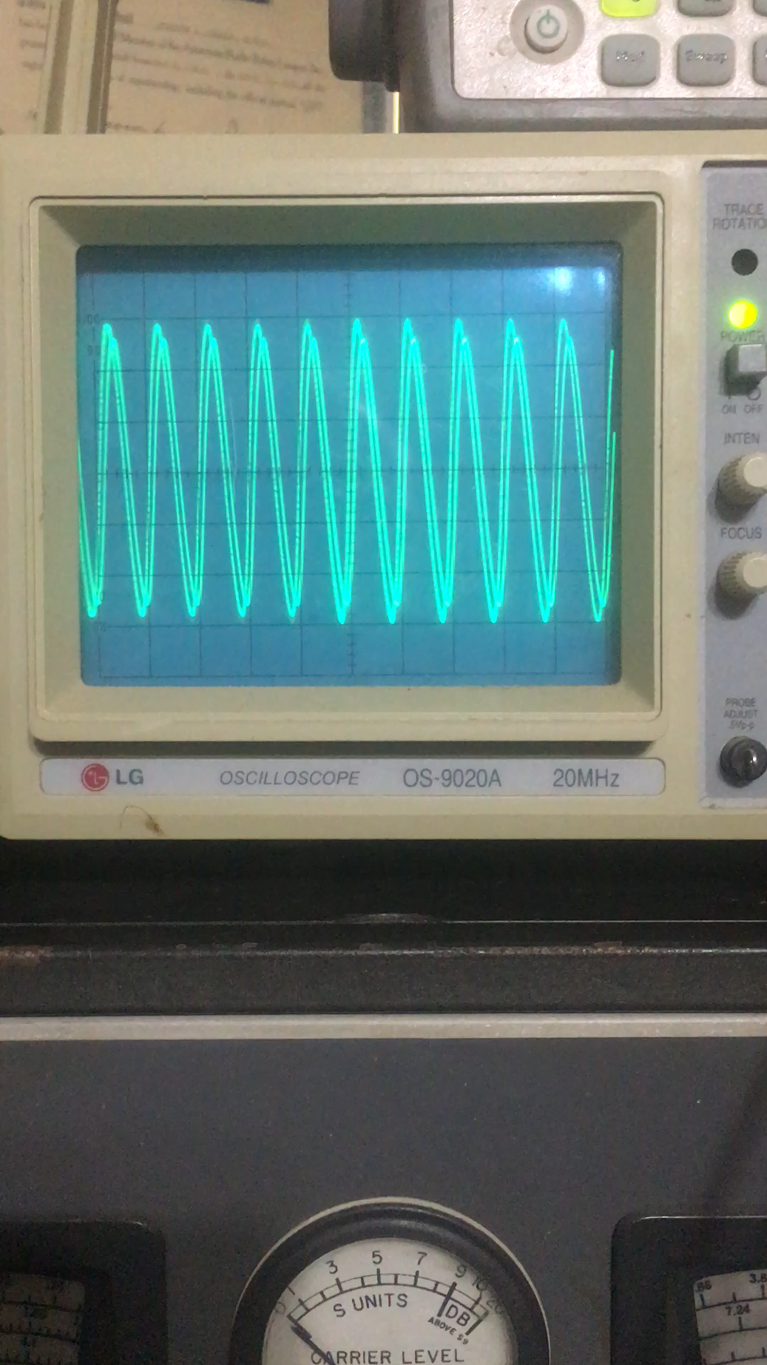
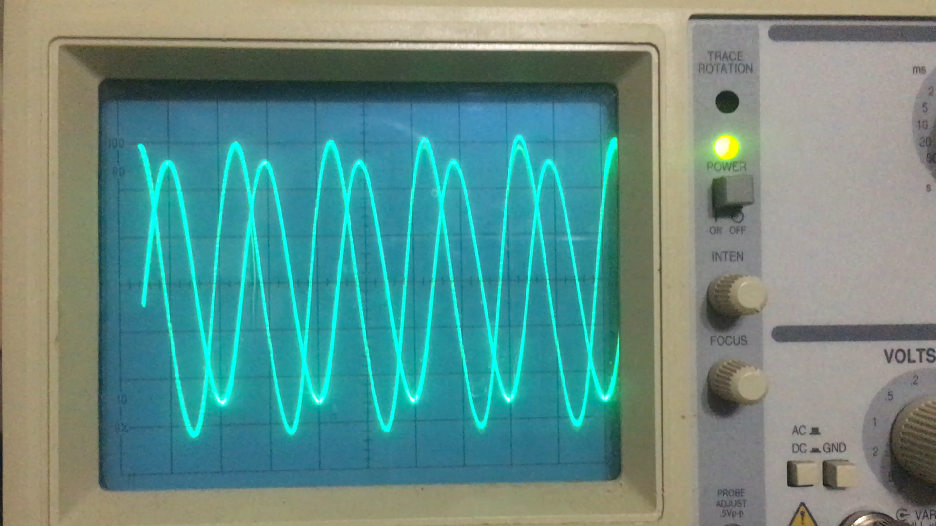
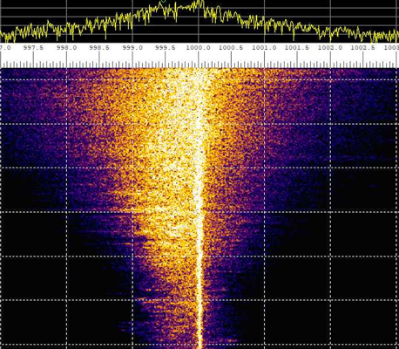
Time Domain Video Displays for Analysis of Short Term Variations
Two tones with atomic accuracy and stability: A GPSDO stabilized function generator (fixed) and on-air 5 MHz WWV (variable). The difference is that WWV arrived by ~850 mile skywave.
Steady Amplitude with Slowly Increasing Frequency
Rapid Amplitude Flutter with Increasing Frequency
Amplitude Flutter with Phase Reversals
Spectrogram Showing Symmetrical Frequency Spread Suggestive of Modulation Sidebands
N.B. WWV tone passed through 1 kHz
BPF with 10 Hz bandwidth to strip Station
audio modulations.
Notes:
Insights into propagation phenomena are also available in short term observations. These dual trace oscilloscope videos show short term variations in frequency and amplitude in real time. Two 1kHz sine waves are displayed in each video. The stable trace is from a GPSDO-stabilized laboratory function generator. The variable trace is the 5MHz WWV carrier down converted to 1kHz and passed through a 10Hz wide BPF to strip off audio modulation. So here are two tones generated with atomic clock precision. The difference is that WWV arrived over a 850-mile skywave path and was modulated in amplitude and frequency by the ionosphere. The upper left video shows conditions of relative calm, with WWV amplitude remaining fairly steady while slowly drifting upwards in frequency. The upper right video shows significant short term amplitude flutter with a much quicker upwards frequency drift. Finally the lower left video shows amplitude fluctuations that include phase reversals, where the envelope amplitude goes through zero. Considering the ionosphere as a modulator infers the production of modulation sidebands, which exist as symmetrical frequency excursions about a center frequency. The lower right spectrogram shows an example of symmetrical frequency excursions or “fuzz” that may well be modulation sidebands. They are centered about a frequency track that splits low in frequency from a non-shifted track during an evening transition.

Slide 9
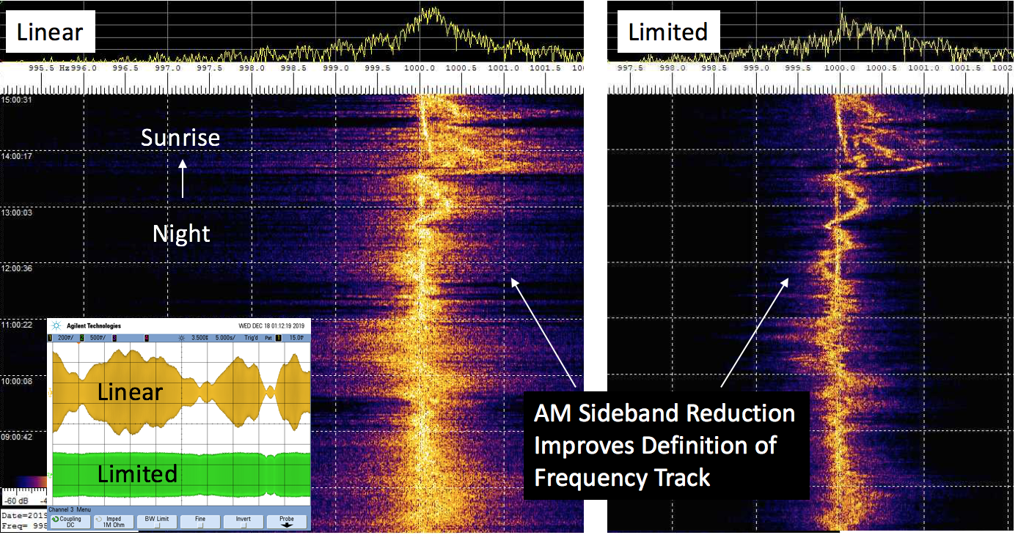
Passing Downconverted Carrier Through a Hard Limiter Sharpened Spectrogram by Stripping Amplitude Information
Notes:
Spectrograms have been noted on several occasions to be fuzzy in appearance like the one on the left in this figure. An experiment was devised to test the theory that the fuzz may be AM sidebands from rapid amplitude flutter. The downconverted carrier was passed through a hard limiter to strip amplitude information while leaving frequency information intact, in the manner of a conventional FM receiver. The oscilloscope inset on the lower left shows the appearance of the linear and limited signals in the time domain. The spectrogram on the left was made with the linear data and the one on the right with the limited version. The limiting process removed much of the fuzz and significantly sharpened the frequency track. This experiment supports the premise that much of the fuzzy appearance of the linear spectrogram was from AM sidebands.

Slide 10
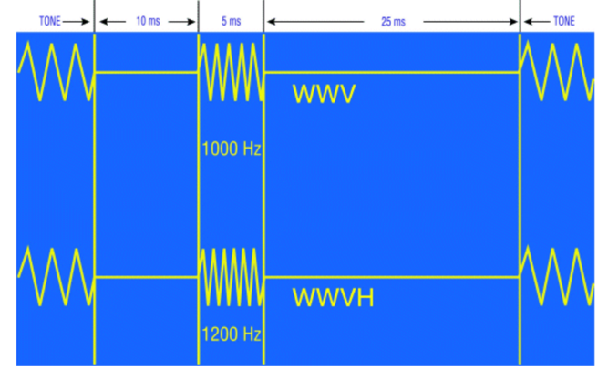
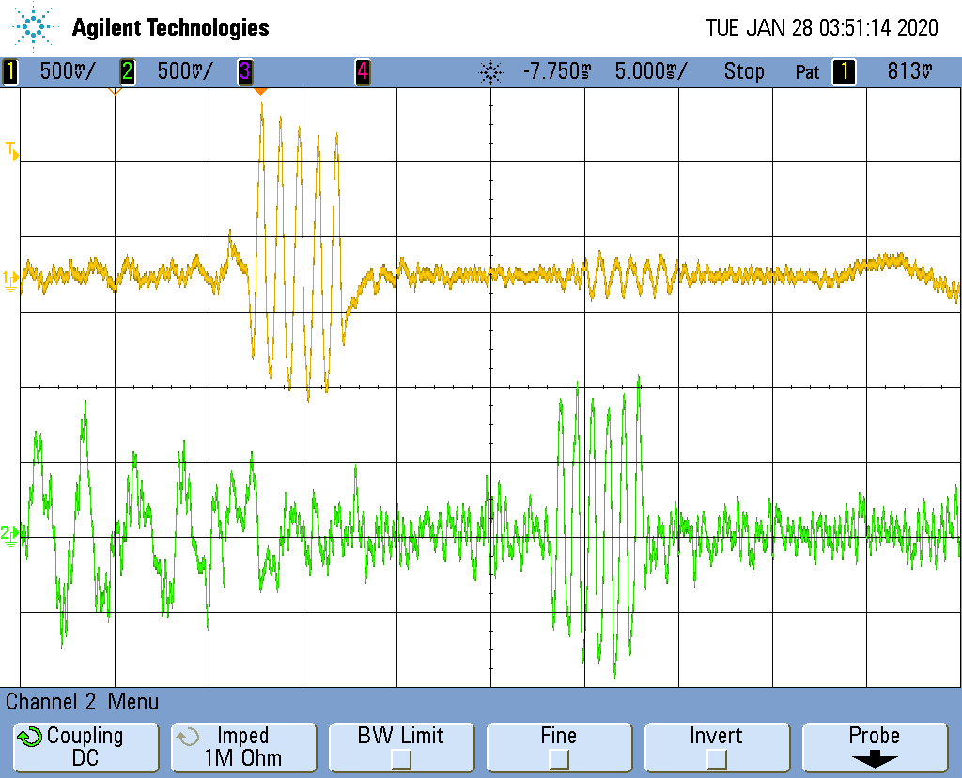

Time of Flight Measurements Using WWV Per-Second Timing Ticks
Simultaneous reception of WWV and WWVH on 5 MHz
5 MHz WWV + WWVH
WWVH
WWV
10 MHz
WWVH Only
Published Timing Tick Information:
WWV – 5 cycles of 1000 Hz
WWVH – 6 cycles of 1200 Hz
Alternating 500/600 tone frequencies
A sync reference can be obtained from the 1 pps output from a GPSDO.
On-the-air reception of WWV and WWVH Timing Ticks At WA5FRF. Time difference of arrival is ~17mS.
WWV at 1350 km, WWVH at 6050 km great circle dist.
Notes:
Measuring the Time of Flight of the radio wave from WWV to a receiving station can be a useful tool to help determine the path length through the ionosphere. Path length can be used along with a geometric analysis to infer the number of hops. Such a measurement can be made using the per-second timing ticks transmitted by WWV and the precise time of launch reference available in the 1 pps output from a GPSDO. The timing ticks are 5mS long and consist of 5 cycles of a 1kHz tone for WWV and 6 cycles of a 1.2kHz tone for WWVH. This audio recording gives an example of the per-second ticks during the audio time announcements prior to the top of each minute. Both WWVH female voice and WWV male voice were coming in at the time of the recording. (play audio) The oscilloscope record shows the appearance of the ticks from a receiver set in AM mode. The top yellow trace shows the 5 cycle tick from 5MHz WWV followed 17mS later by the 6 cycle tick from the more distant WWVH. The bottom green trace shows good copy of the WWVH tick on 10MHz but no copy from WWV.

Slide 11
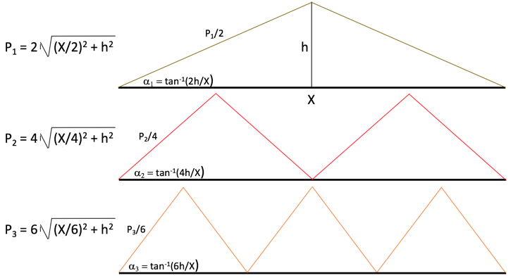
Idealized Geometry for 1, 2, and 3 Hop Paths Used to Approximate Expected Pulse Timing
h = virtual height
3-hops
2-hops
Primary 1-hop mode
For ground distance (X) of 1350km and reflection heights (h) from 150-300km, the differences in arrival times between the 1 and the 2 & 3 hop modes range from 0.3 to 4 milliseconds. This means the 2-hop and 3-hop pulses will come down within the 5 mS Primary pulse length, resulting in superposition.
Simplifications:
“Flat Earth” 2D geometry
Perfect reflections at constant virtual height
Constant wave speed = c
Notes:
In order to get a feel for what the times of flight might be from CO to TX, I used a simplified geometric model. The model shown on the left predicts path lengths for 1, 2, and 3 hop modes as a function of virtual height of the ionosphere. This simplified model assumes a “flat earth” geometry, perfect wave reflection at the virtual height, and a constant wave speed of c. The path lengths were computed on a spreadsheet, converted to Time of Flight, and plotted as a function of virtual height over a span of 100 to 400 km in the graph on the right. For ground distance of 1350km and reflection heights in the range of 150-300km, the differences in arrival times between the 1 and the 2 & 3 hop modes range from 0.3 to 4 milliseconds. But the timing tick is 5mS long. This means the 2-hop and 3-hop pulses will come down on top of the 1-hop primary pulse, resulting in superposition. This graph also illustrates increasing slopes for 2 and 3 hop modes. So for a given descent rate in virtual height the multiple hop modes will experience a faster closure rate and incur more Doppler.

Slide 12
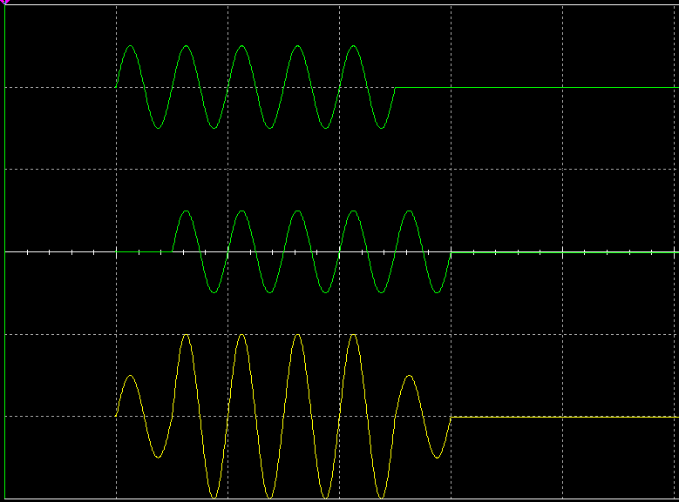
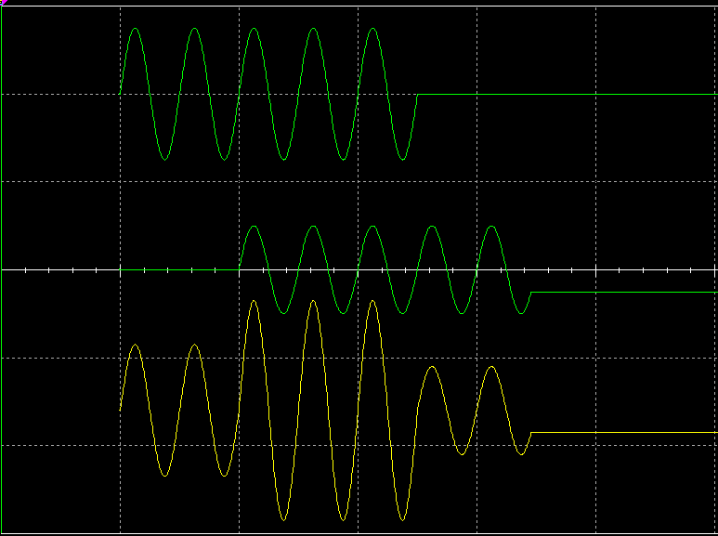
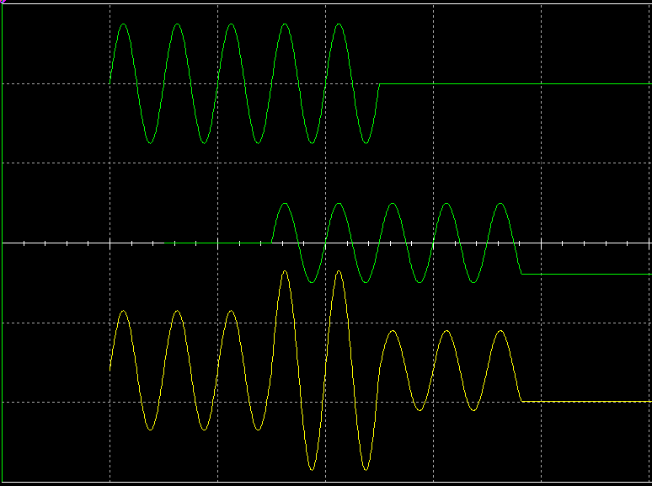
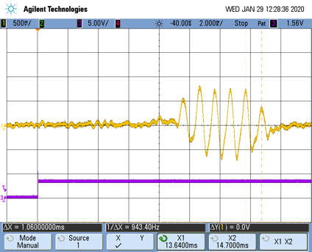
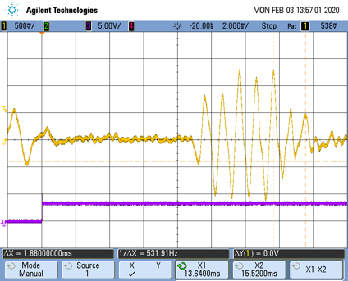
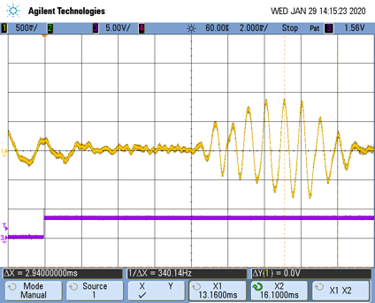
The Time Delays Between Multiple Modes are Less Than the Pulse Width. Therefore the Primary and Delayed Pulses Overlap, Lengthening the Pulse by Superposition.
Pulse 1
Simulated
Pulse 2
Sum
1 mS Delay -> 6 cycles
2 mS Delay -> 7 cycles
3 mS Delay -> 8 cycles
Pulse Extension
Primary Pulse
Measured
GPSDO 1pps Sync
Timing data was extracted by measuring time delay from the GPSDO sync to the leading edge for the primary pulse and by the pulse extension on the trailing edge for the delayed pulses. Timing data was acquired over the 4 hour dawn transition on January 29, 2020.
Notes:
The Time Delays Between Multiple Modes are Less Than the Pulse Width. Therefore the Primary and Delayed Pulses Overlap, Lengthening the Pulse by Superposition. The top row of illustrations shows Spice simulations for superposition delays of 1, 2, and 3 mS. The net effect of overlapping arrivals is to lengthen the overall pulse. Beneath each simulation is an oscilloscope recording showing actual WWV on-the-air captures depicting exactly these situations. Note the first cycle of the primary mode and the last cycle of the delayed have no overlap and are free from superposition distortion. Therefore a preferred measurement technique is to measure the TOF of the primary pulse by referencing the leading edge and delayed arrivals by referencing the trailing edge. The rising edge of the GPSDO 1-pps output is used to sync the scope. Time measurement must take into account the time delay through the receiver and use repeatable on-time markers on the pulses. I used the middle of positive half-cycles and corrected for the time difference to the beginning of the pulse.

Slide 13
Scatter Plot of Primary and Delayed Pulses Clustered in Sequences Suggestive of Multiple Hop Modes
- Negative slopes are consistent with decreasing path lengths from descending ionization layer.
- Abrupt appearance of 3 Hop mode is consistent with spectrogram data and high angle propagation theory
SR WA5FRF 1325z
4 Hop or Pedersen?
3 Hop
2 Hop
1 Hop
Actual arrival times of second and third delayed pulses can be estimated by adding the delay times in the top graph to the Primary arrival times in the bottom graph. Effective virtual height descent rate available from slopes.
Notes:
Data records were acquired manually over a 4-hour period during a morning transition. The timing to the primary and delayed pulsed were extracted and plotted in Excel as a scatter plot. The data points clustered in layers consistent with single and multiple hop modes. The negative slope indicates decreasing TOF with time, consistent with descending ionization. The abrupt manifestation of the highest order modes is consistent with the premise that the high order modes must wait for the propagation to support the required takeoff angle.

Slide 14
Measured TOF’s were Consistent with Theoretical TOF’s for a 255km Refraction Layer and Support Premise that Delayed Pulses Are from Multiple Hops
Matched
Scales
4 Hop
WA5FRF Sunrise 1325z
WWV Sunrise 1414z
3 Hop
2 Hop
1 Hop
Geometric Times Of Flight plotted in descending order and cropped to approximately match measured data.
Notes:
The plots on the right are the measured data with linear interpolation of the missing points and superimposed trend lines. On the left is the TOF data computed from the geometric model, but reversed in order so layer height decreases from left to right. These curves were selected and cropped so the times of flight approximately matched the interpolated data. This crude comparison gives a pretty good matchup of Times of Flight and slopes for a layer height centered at 255km. This value was consistent with ray trace predictions for that day.

Slide 15
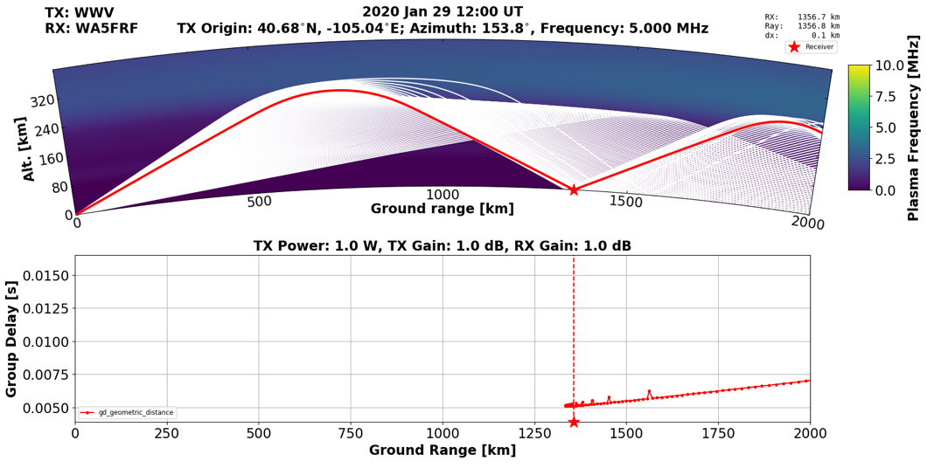
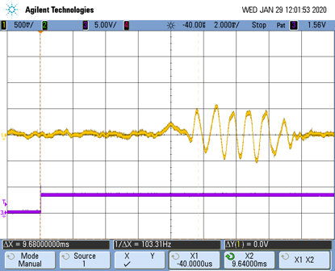
Measured 1-Hop Arrival Time is Consistent with Single Hop PHaRLAP Ray Trace Modeling
PHaRLAP Simulation Data Provided by Nathaniel Frissell W2NAF
Refraction height inferred from idealized geometry consistent PHaRLAP prediction.
GPSDO Timing
Measured TOF
IC-7610 Proc Delay
Predicted group delay near 5 mS consistent with measured arrival time of 4.93 mS for primary 1-hop mode at 1201z. T = 9.68 (GPSDO) – 4.75 (IC-7610) = 4.93 mS.
Measured Data
Notes:
This is a side-by-side comparison of Times of Flight measured during the timing experiment and ray trace predictions from PHaRLAP provided by Nathaniel Frissell W2NAF. The measured 1-hop TOF compared well to PHaRLAP predictions for this date and time. PHaRLAP predicted a TOF of just over 5mS at 1200z. A data record was available at 1201z that produced a TOF measurement of 4.93mS.

Slide 16
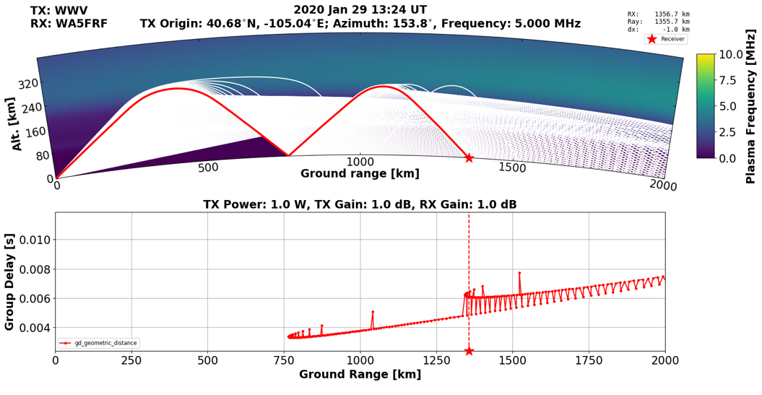
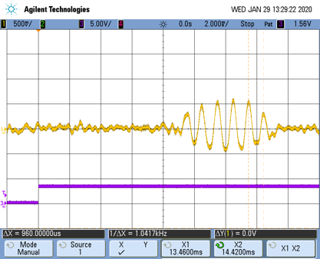
Measured 2-Hop Arrival Time is Consistent with
PHaRLAP Ray Trace Modeling
PHaRLAP Simulation Data Provided by Nathaniel Frissell W2NAF
Refraction height inferred from timing experiment consistent PHaRLAP prediction.
2-Hop Pulse
Extension
GPSDO Timing
Measured Delayed TOF
IC-7610 Proc Delay
Measured Primary TOF
Predicted group delay near 6 mS consistent with measured 2-hop arrival time of 5.67 mS at 1329z. T = 9.46 (GPSDO) – 4.75 (IC-7610) + 0.96 (Extension) = 5.67 mS
Measured Data
Notes:
This is a PHaRLAP ray trace prediction extended to a 2-hop mode. The measured 1-hop and 2-hop TOF’s compared well to PHaRLAP predictions for this date and time. The PHaRLAP plot shows a 2-hop TOF around 6mS at 1324z. A data record was available at 1329z that produced a 2-hop TOF measurement of 5.67mS.

Slide 17
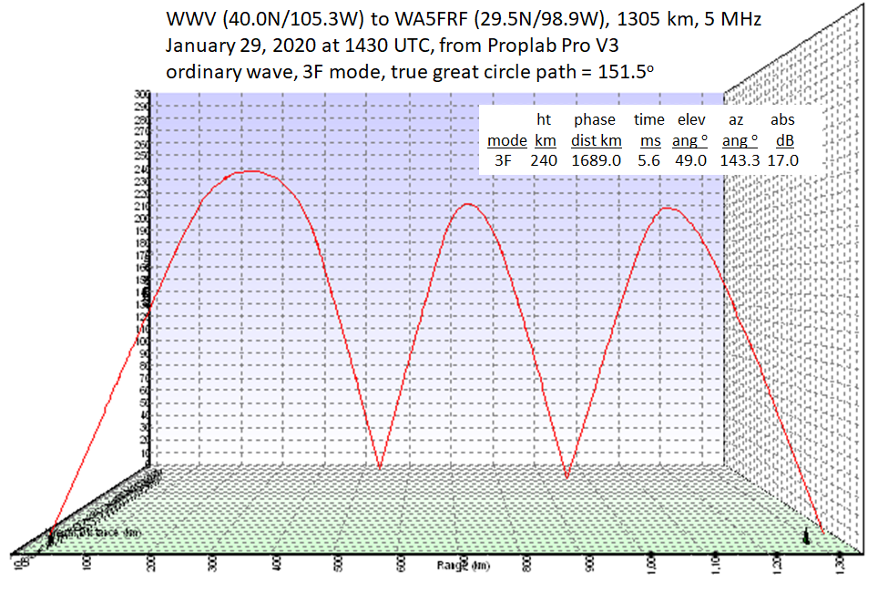
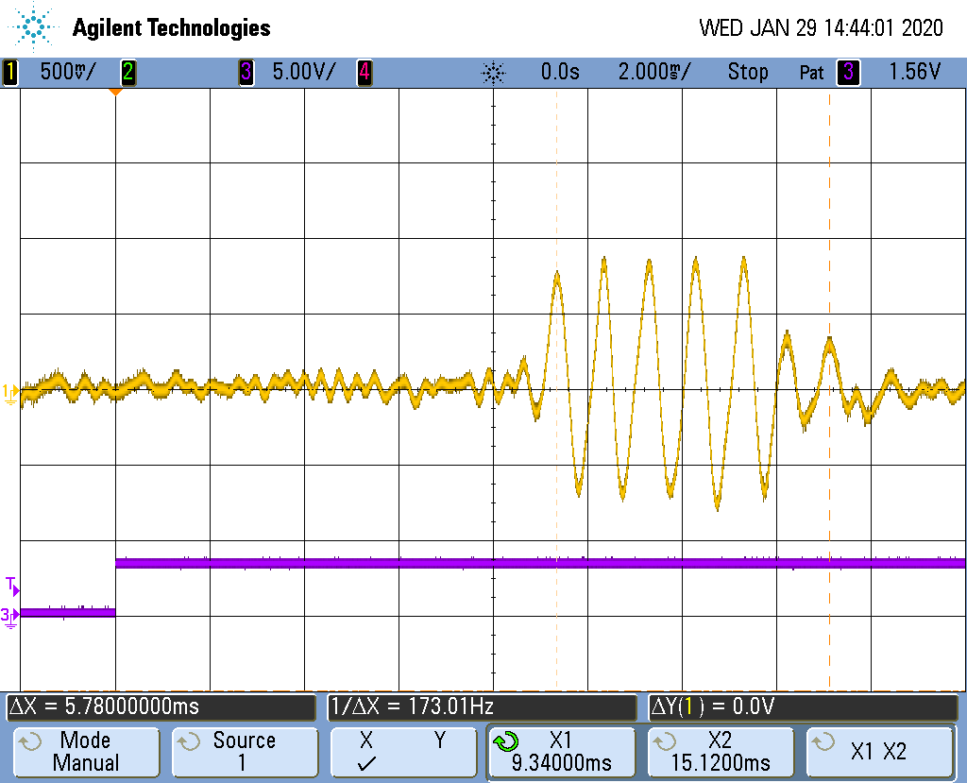
Measured 3-Hop Arrival Time is Consistent with 3F Proplab Pro 3D Ray Trace Modeling
Proplab Pro V3 (IRI 2007) simulations provided by Carl Luetzelschwab K9LA
Measurement
= 9.35 mS
T_{meas}= 5.78 mS
4cy = 4.0mS
IC7610
4.75 mS
First and last cycles undistorted by superposition
Measured 3F TOF = Leading Edge – IC7610 + T_{meas} – 4 cy
= 9.35 – 4.75 + 5.78 - 4.0 = 6.38 mS
The best measurement technique is to reference the leading cycle of the primary and last cycle of the delayed pulses since they are not distorted by superposition.
Notes:
This 3-hop ProplabPro ray trace prediction was provided by Carl Luetzelschwab K9LA. The measured 3-hop TOF compared well to the predictions for this date and time. The 3D Proplab program predicted a 3-hop TOF of 6.46mS at 1430z. A data record was available at 1444z that measured a 3-hop TOF of 6.38mS.

Slide 18
Separation of WWV and WWVH During Simultaneous Reception
There are many times when the band is open to both WWV in Colorado and WWVH in Hawaii. Because they are on the same frequency the spectral contributions overlap in a spectrogram.
WWV and WWVH alternately transmit standard side tones of 500 and 600 Hz on most (but not all) minutes of each hour. See https://tf.nist.gov/stations/iform.html . Their use as a separation tool was recognized by David Kazdan AD8Y.
These signals are as precise as the carrier and can be used to separately measure Doppler data if recovered as an Upper Side Band (USB) tone.
Minute WWV WWVH
Even 500 Hz 600 Hz
Odd 600 Hz 500 Hz
Numerous separation schemes are possible using one or both tones. The option reported here is a fully deinterlaced technique that places 100% continuous data records for each station on separate outputs. The method requires two receivers with the ability to change frequency every minute so that one receiver continuously monitors WWV and the other WWVH. This method is also useful using only one programmable receiver to yield 100% data on just one station.
Notes:
There are many times when the band is open to both WWV in Colorado and WWVH in Hawaii. Because they are on the same frequency the spectral contributions overlap in a spectrogram. WWV and WWVH alternately transmit standard side tones of 500 and 600 Hz on most minutes of each hour. These signals are as precise as the carrier and can be used to separately measure Doppler data if recovered as an Upper Side Band (USB) tone. Numerous separation schemes are possible using one or both tones. The option reported here is a fully deinterlaced technique that places a 100% continuous data records for each station on a separate output for recording. This method requires two receivers with the ability to change frequency every minute so that one receiver continuously monitors WWV and the other WWVH.

Slide 19
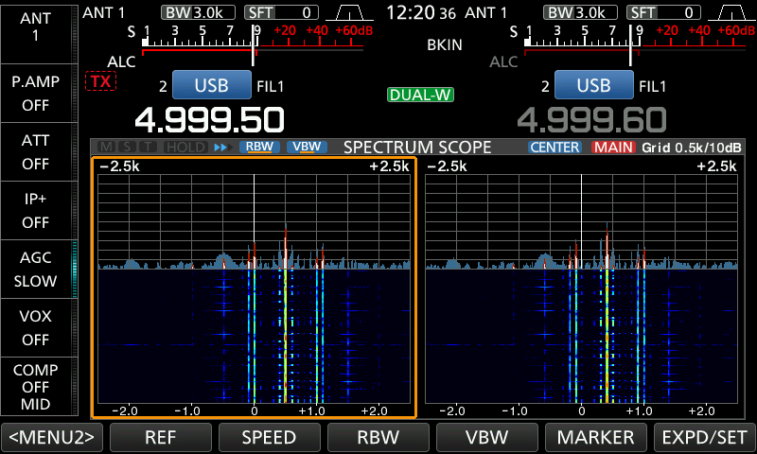
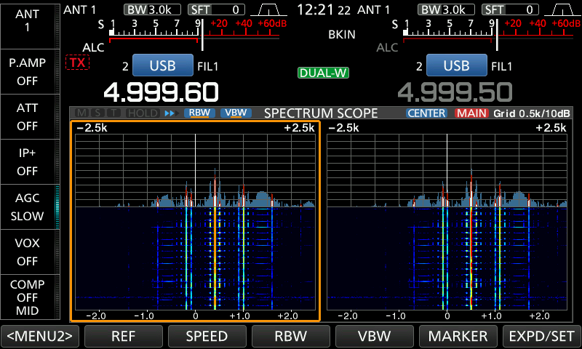
Deinterlace Scheme Using Dual (or Two) Receivers to Separate WWV and WWVH
MAIN = f_{C} – 0.5; SUB = f_{C} – 0.4; CHANGE every minute
Even minute:
MAIN on 500Hz for WWV
SUB on 600Hz for WWVH
Radio with
Dual Receivers
(e.g., IC-7610)
A
1kHz Output Tone
A: always WWV
B: always WWVH
B
4.999.50 translates
500Hz USB to 1000Hz
4.999.60 translates
600Hz USB to 1000Hz
Change A/B
MAIN always WWV SUB always WWVH
Radio Interface
(e.g., CI-V)
- Or Manual -
Odd / Even
e.g., LSB of Minute Digit
Odd minute:
MAIN on 600Hz for WWV
SUB on 500Hz for WWVH
Odd/Even Minute
Determination
(e.g., Radio Controlled Clock)
Method can be automated if odd/even minutes can be sensed electronically.
N.B. Scheme also works with a single receiver with programmable VFO or memory channels to output either WWV or WWVH alone.
IC-7610 screenshots in the two modes required to deinterlace the WWV/WWVH side tones. The radio was stabilized with a GPSDO.
Notes:
The author’s Icom IC-7610 has two receivers and was an ideal platform for WWV/WWVH separation experiments when stabilized with an external GPSDO. The audio outputs from the MAIN and SUB receivers were fed to two separate laptop computers running Spectrum Lab. The MAIN receiver was set up to initially translate the 500Hz tone to 1000Hz and the SUB receiver was set up to translate the 600Hz tone to 1000Hz. This is the tone used as a center frequency in the Spectrum Lab programs. Deinterlace was accomplished by switching the MAIN and SUB channels manually by pressing the CHANGE button during the voice time announcements a few seconds before the top of each minute. This manually controlled experiment was performed to demonstrate feasibility of the method to produce completely separated spectrograms. But the method could be automated with the 7610 by interfacing a radio controlled clock to the CI-V interface to toggle the MAIN/SUB receiver frequencies automatically.

Slide 20
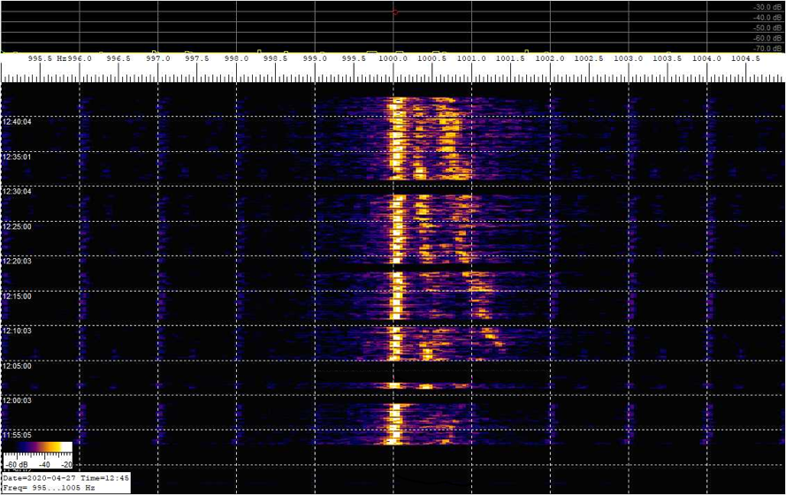
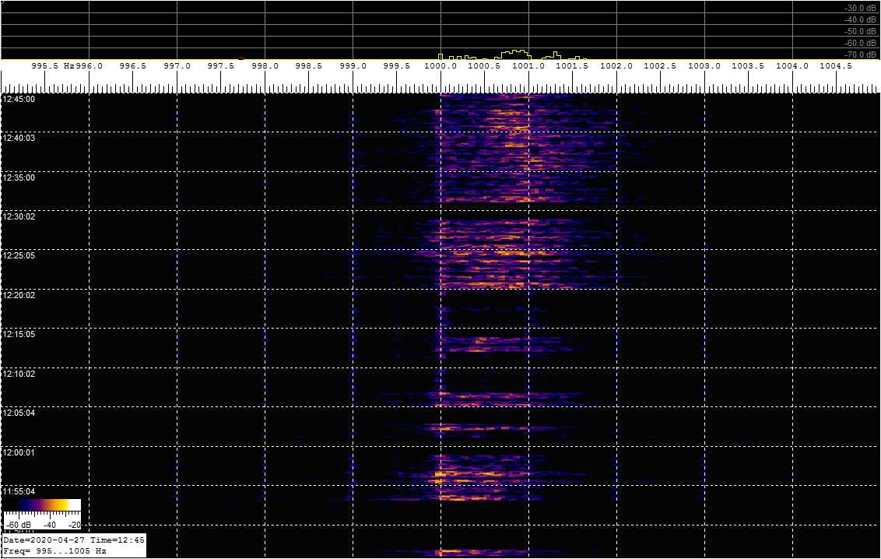
Completely Deinterlaced WWV and WWVH Data
- IC-7610 Dual Receivers Using CHANGE to Manually Switch MAIN and SUB –
- Data is Present for Each Tone Every Minute It is On the Air -
Dawn Transition on 04-27-2020
Only WWV on MAIN
(Multiple Modes Present)
Only WWVH on SUB
(Single Mode Present)
Notes:
These two spectrograms show the completely separated data streams with WWV on the left and WWVH on the right. The data traces show all of the available transmitted data; the missing minutes are those intentionally not transmitted by WWV. The short gaps between sequential traces are when the tones are muted for the voice announcements prior to the top of each minute. The scale factors were kept the same for both spectrograms so relative amplitude information would be preserved in trace brightness. Mode splitting is clearly present in the WWV trace. The WWVH trace shows a mostly single diffuse mode with a different amplitude profile. Without deinterlacing these spectra would have been superimposed. The mode splitting on WWV would still be evident but blurred by the presence of the WWVH spectra. The spectral information on WWVH would have simply been unrecognizable and lost.

Slide 21
Conclusions and Acknowledgements
Using experimental tools targeting specific ionospheric behavior can help decipher the multiple physical processes involved. The purpose of this paper was to give examples of some of the tools developed for the HamSCI community.
The results of the studies conducted to date support that at least some of the observed mode splitting may result from different Doppler shifts for multiple hop modes. But the data shows much more complexity than can be accounted for by this one mechanism. Alternate explanations have been proposed and are the subject of future research. An automated TOF data collection system with simultaneous spectrogram data would be of immense help.
The author would like to thank Nathaniel Frissell W2NAF, Carl Luetzelschwab K9LA, David Kazdan AD8Y, Bill Liles NQ6Z, and Bill Engelke AB4EJ for their valuable insights and many excellent technical discussions.
We gratefully acknowledge support to this project from NSF Grants AGS-2002278, AGS-1932997, and AGS-1932972
Notes:
Using experimental tools targeting specific ionospheric behavior can help decipher the multiple physical processes involved. The purpose of this paper was to give examples of some of the tools developed for the HamSCI community.
The results of the studies conducted to date support that at least some of the observed mode splitting may result from different Doppler shifts for multiple hop modes. But the data shows much more complexity than can be accounted for by this one mechanism. Alternate explanations have been proposed and are the subject of future research. An automated TOF data collection system with simultaneous spectrogram data would be of immense help.
The author would like to thank Nathaniel Frissell W2NAF, Carl Luetzelschwab K9LA, David Kazdan AD8Y, Bill Liles NQ6Z, and Bill Engelke AB4EJ for their valuable contributions, insights, and many excellent technical discussions.
We gratefully acknowledge support to this project from NSF Grants AGS-2002278, AGS-1932997, and AGS-1932972

